Slide 1


Slide 2
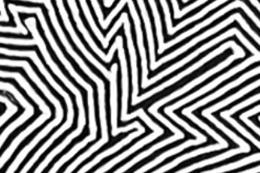
Artificial Intelligence Admitting the Possibilities of Error
Kirsten Lavers and Peter Murray-Rust
Kirsten Lavers’ drawings speak to many areas of science and mathematics. This very informal workshop will explore these ideas and help Kirsten and Peter refine their ideas and popularise them outside the artistic world.
The audience is an integral part.
No knowledge of science is required Wikipedia links provided
Copyright: Both Kirsten and Peter have liberal approaches to copyright (CC BY)

Slide 3
Programme
Introductions including audience
PMR vision of KL drawings
Algorithms (short practical session)
What is AI and vibe-coding? We write an algorithm
KL conversation with ChatGPT
Display of AtPoE pattern generator program
Discussion

Slide 4
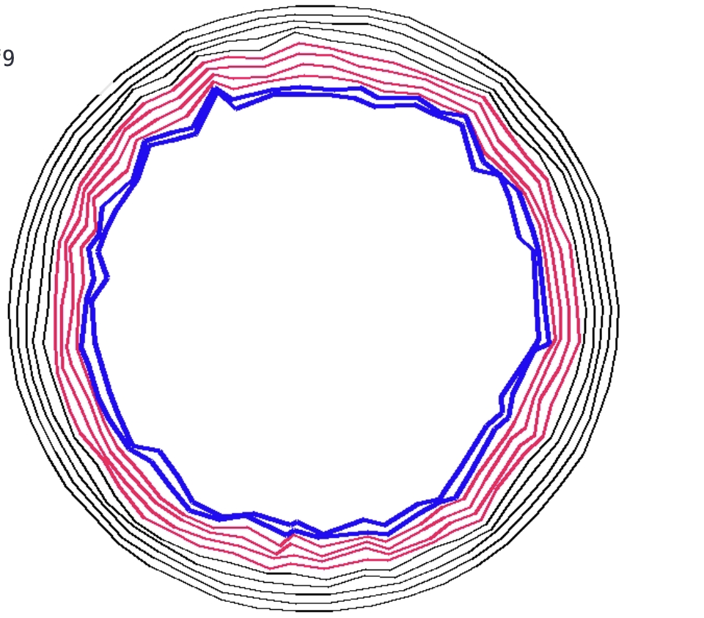
WARNING ! : AIs are NOT sentient*
Human phrases are programmed into them.
“You’re absolutely right!”
“Let me implement the plotting”
I shall converse with them as if they are human, but beware.
The use of AIs is contentious.
We might discuss:
extractive surveillance capitalism
Brain rot of frequent users
Carbon budgets
* https://en.wikipedia.org/wiki/Stochastic_parrot
https://www.c2d3.cam.ac.uk/events/ai-con-conversation-professor-emily-m-bender

Slide 5
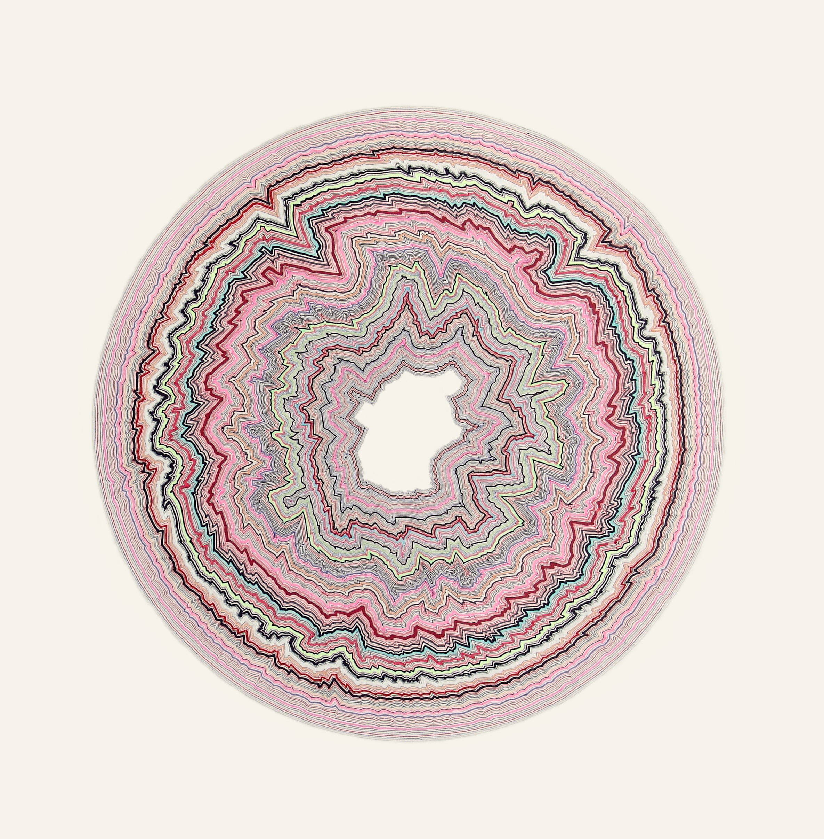
Scientific Topics related to AtPoE
Emergence
Creation
Crystallisation and domains
Instability
Random Error
Error propagation
Symmetry breaking
Iteration
Algorithms
Chaos
Morphogenesis
Cellular Automata
Chirality
Layers
Molecular dynamics

Slide 6
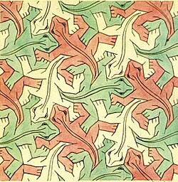
Crystallography and Escher
Forty-five years ago [1960] , a relatively unknown Dutch graphic artist, M.C. Escher, gave a
standing-room-only lecture to the Fifth International Congress of the IUCr in
Cambridge, England. There was an accompanying exhibit of his work that amazed
the crystallographers. His pioneering work in exploring colour symmetry was a rare
instance of an artist investigating a field before “official crystallography even thought
about [it].”[1] Escher's quest to understand periodic tilings (which he called
‘regular divisions of the plane’) was stimulated in 1935 by two articles in
Zeitschrift für Kristallographie; roughly 20 years later crystallographers
(notably, Caroline MacGillavry and J.D.H. and Gabrielle Donnay) sought him out to
learn from his work. In 1960, Escher's book The Graphic Work of M.C. Escher
contained a crystallographer's explanation of symmetry and symmetry groups.
In 1965, the IUCr published [1] for which MacGillavry had collaborated with Escher.
We discuss how Escher's quest to understand the subject of coloured periodic tilings
differed from that of the crystallographers', and how even today, some of his original
investigations are worthy of further scientific inquiry. [1] MacGillavry C.H., Symmetry
Aspects of M.C. Escher's Periodic Drawings, IUCr, Utrecht, 1965. [2] Schattschneider
D., M.C. Escher: Visions of Symmetry, Freeman W.H., New York, 1990, Harry Abrams,
New York, 2004. Keywords: M.C. Escher, colour symmetry, crystallographic teaching
International Union of Crystallography 2005

Slide 7
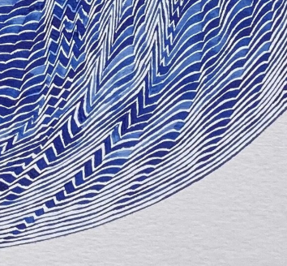
Kirsten’s Algorithm (simple version)
Step0: start with a perfect circle (the boundary polygon) containing a void (normally white)
Step1: start at a position about a pencil-lead width inside the boundary
Rule2: draw with the pencil keeping “close to the boundary” * creating new boundary
Repeat Step1 and Step2 until you are bored or have filled the space
* Not too close, not too far. Just right

Slide 8
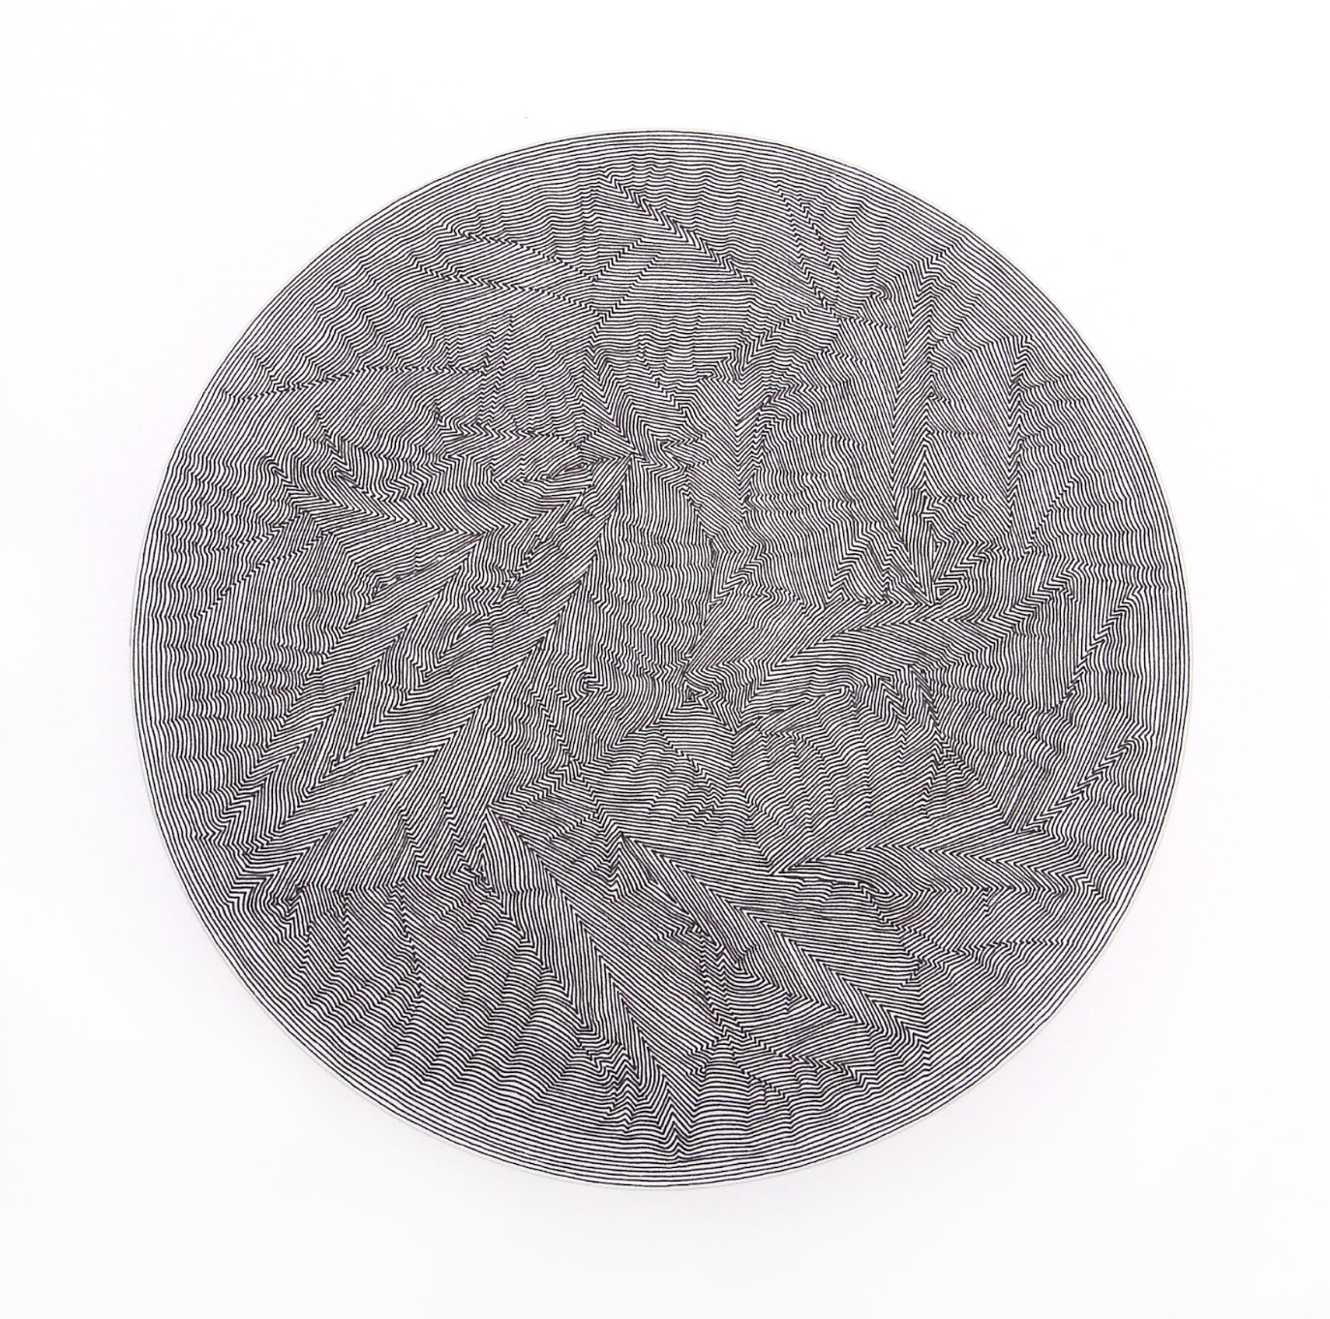

Slide 9
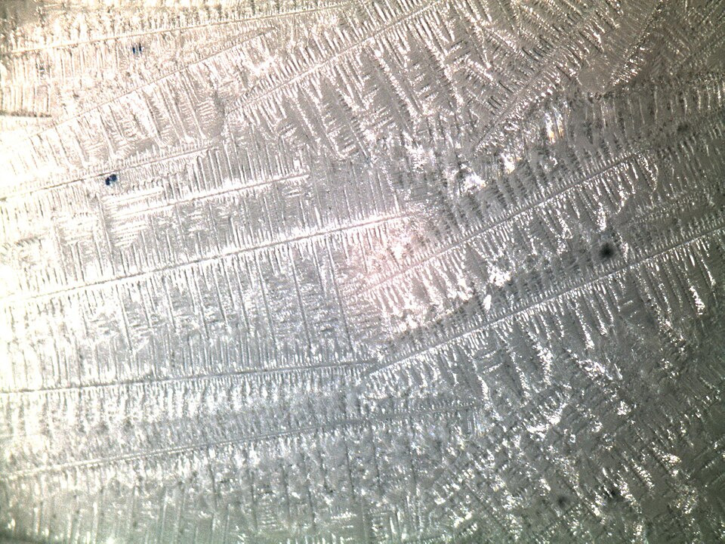
Grains and Domains
https://commons.wikimedia.org/wiki/File:Ammonium_Chloride_Crystals.jpg

Slide 10
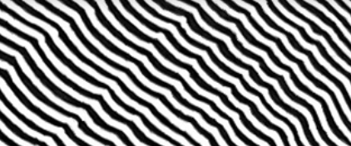
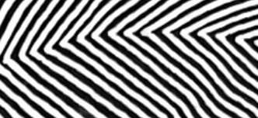
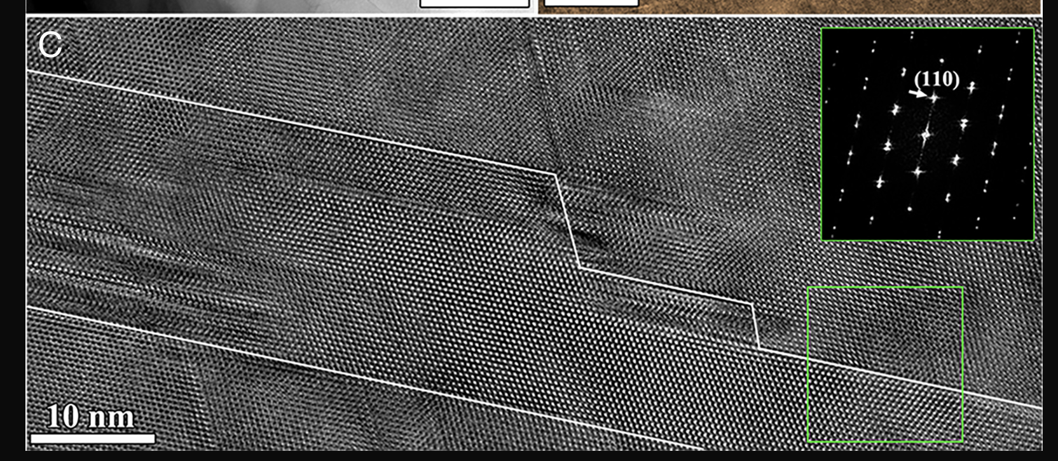
Uncovering the crystal defects within aragonite CaCO₃
Xingyuan San https://orcid.org/0000-0001-7975-7185, Mingyu Gong https://orcid.org/0000-0002-8120-5264, Jian Wang https://orcid.org/0000-0001-5130-300X jianwang@unl.edu, +4 , and Xiaobing Hu https://orcid.org/0000-0002-9233-8118 xbhu@northwestern.eduAuthors Info & Affiliations

Slide 11
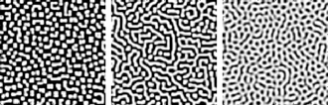
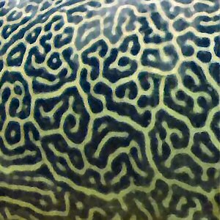
Morphogenesis
Pufferfish
Kirsten
https://en.wikipedia.org/wiki/Turing_pattern
https://en.wikipedia.org/wiki/Reaction%E2%80%93diffusion_system#Two-component_reaction%E2%80%93diffusion_equations

Slide 12
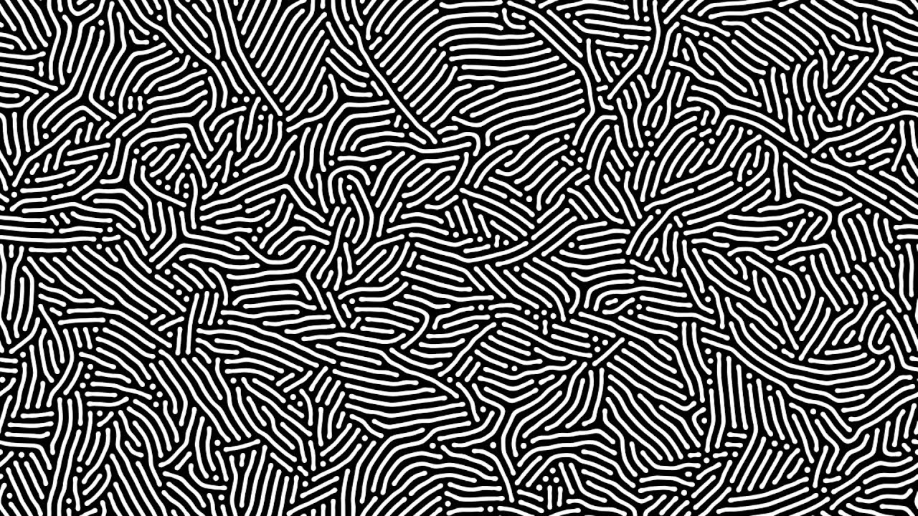
Diffusion-reaction system by P. Gray and S. K. Scott
https://youtu.be/GB7-OQk-fFk?si=kOZvXDeCuHCc5myc

Slide 13
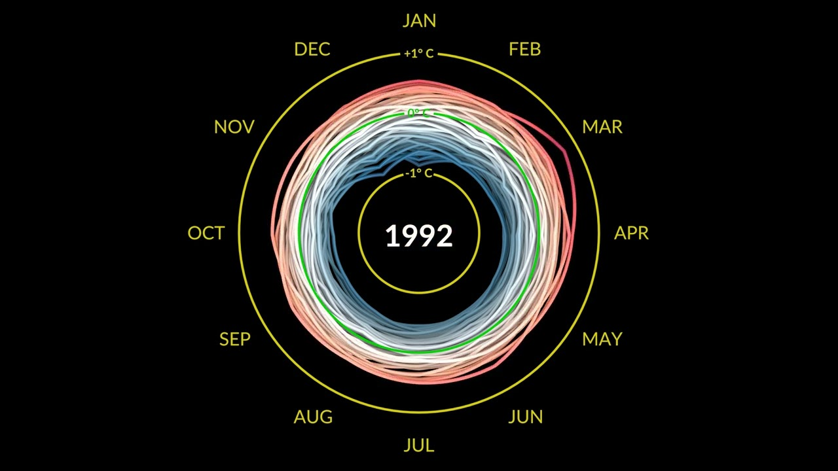
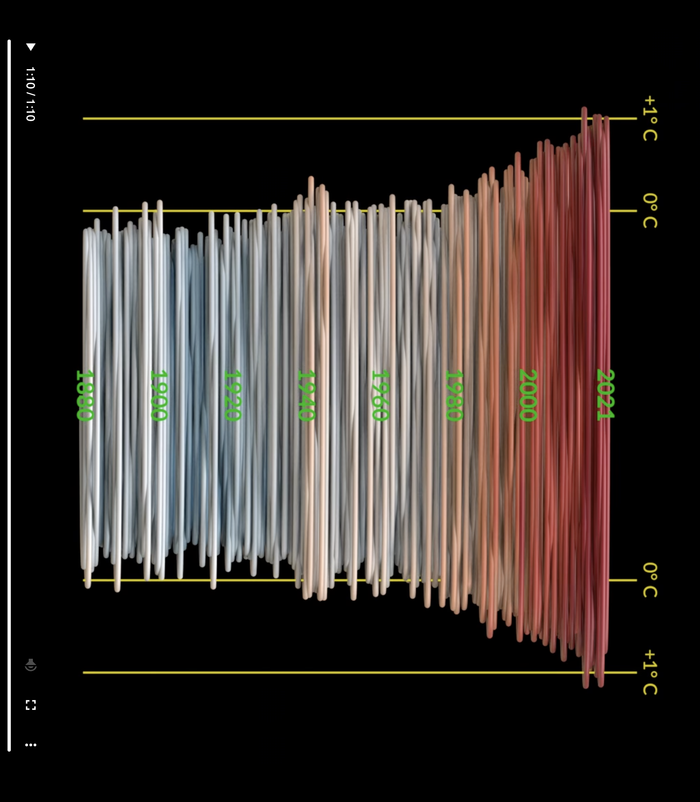
Climate Spiral
Temperature vs Date
Climate Spiral animation
https://youtu.be/jWoCXLuTIkI?si=beOwcBUKVbe6eLaG

Slide 14
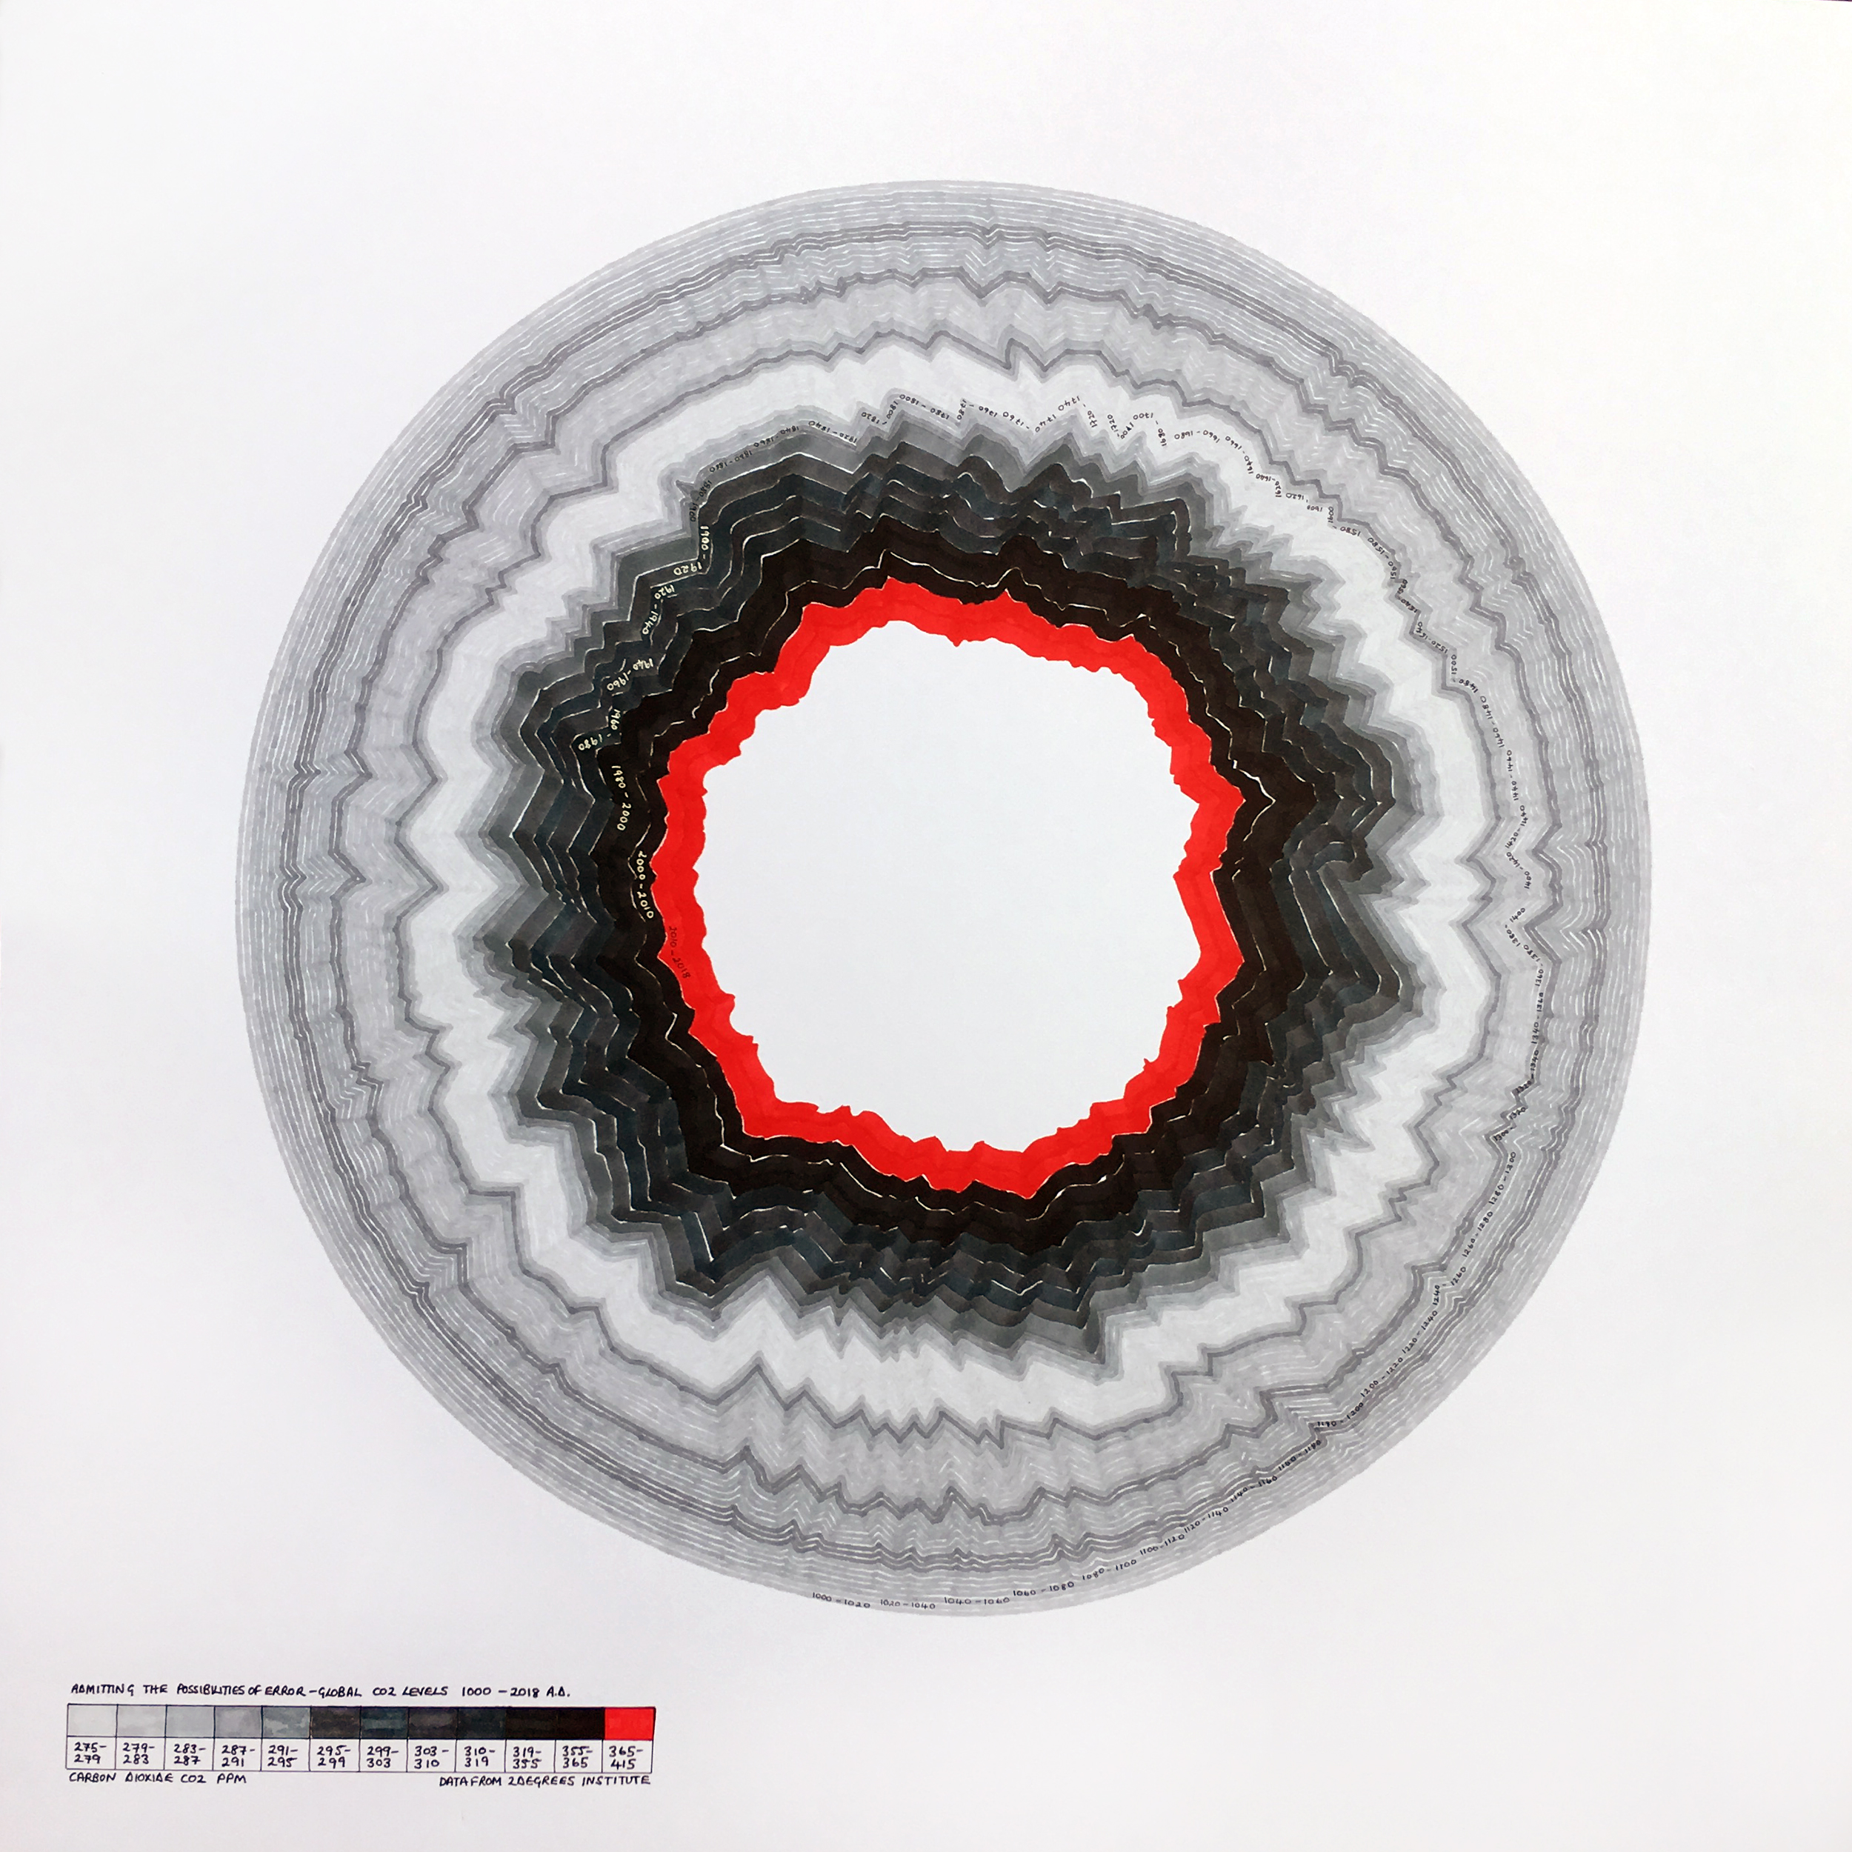
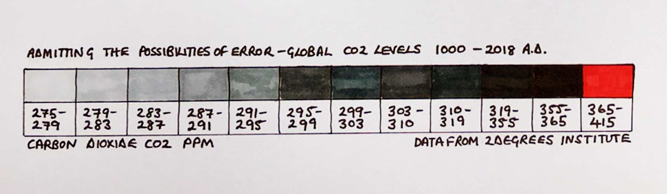

Slide 15
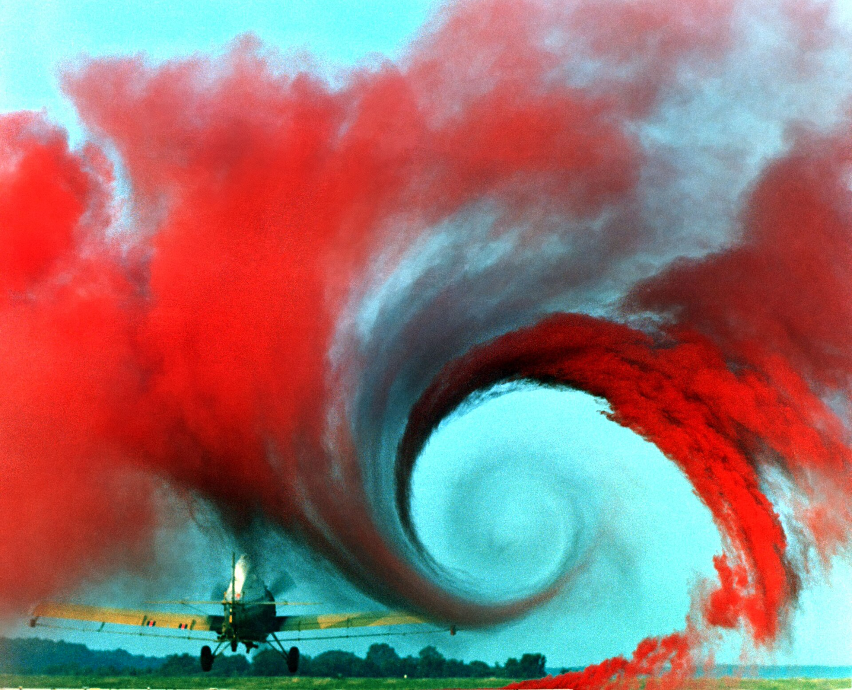
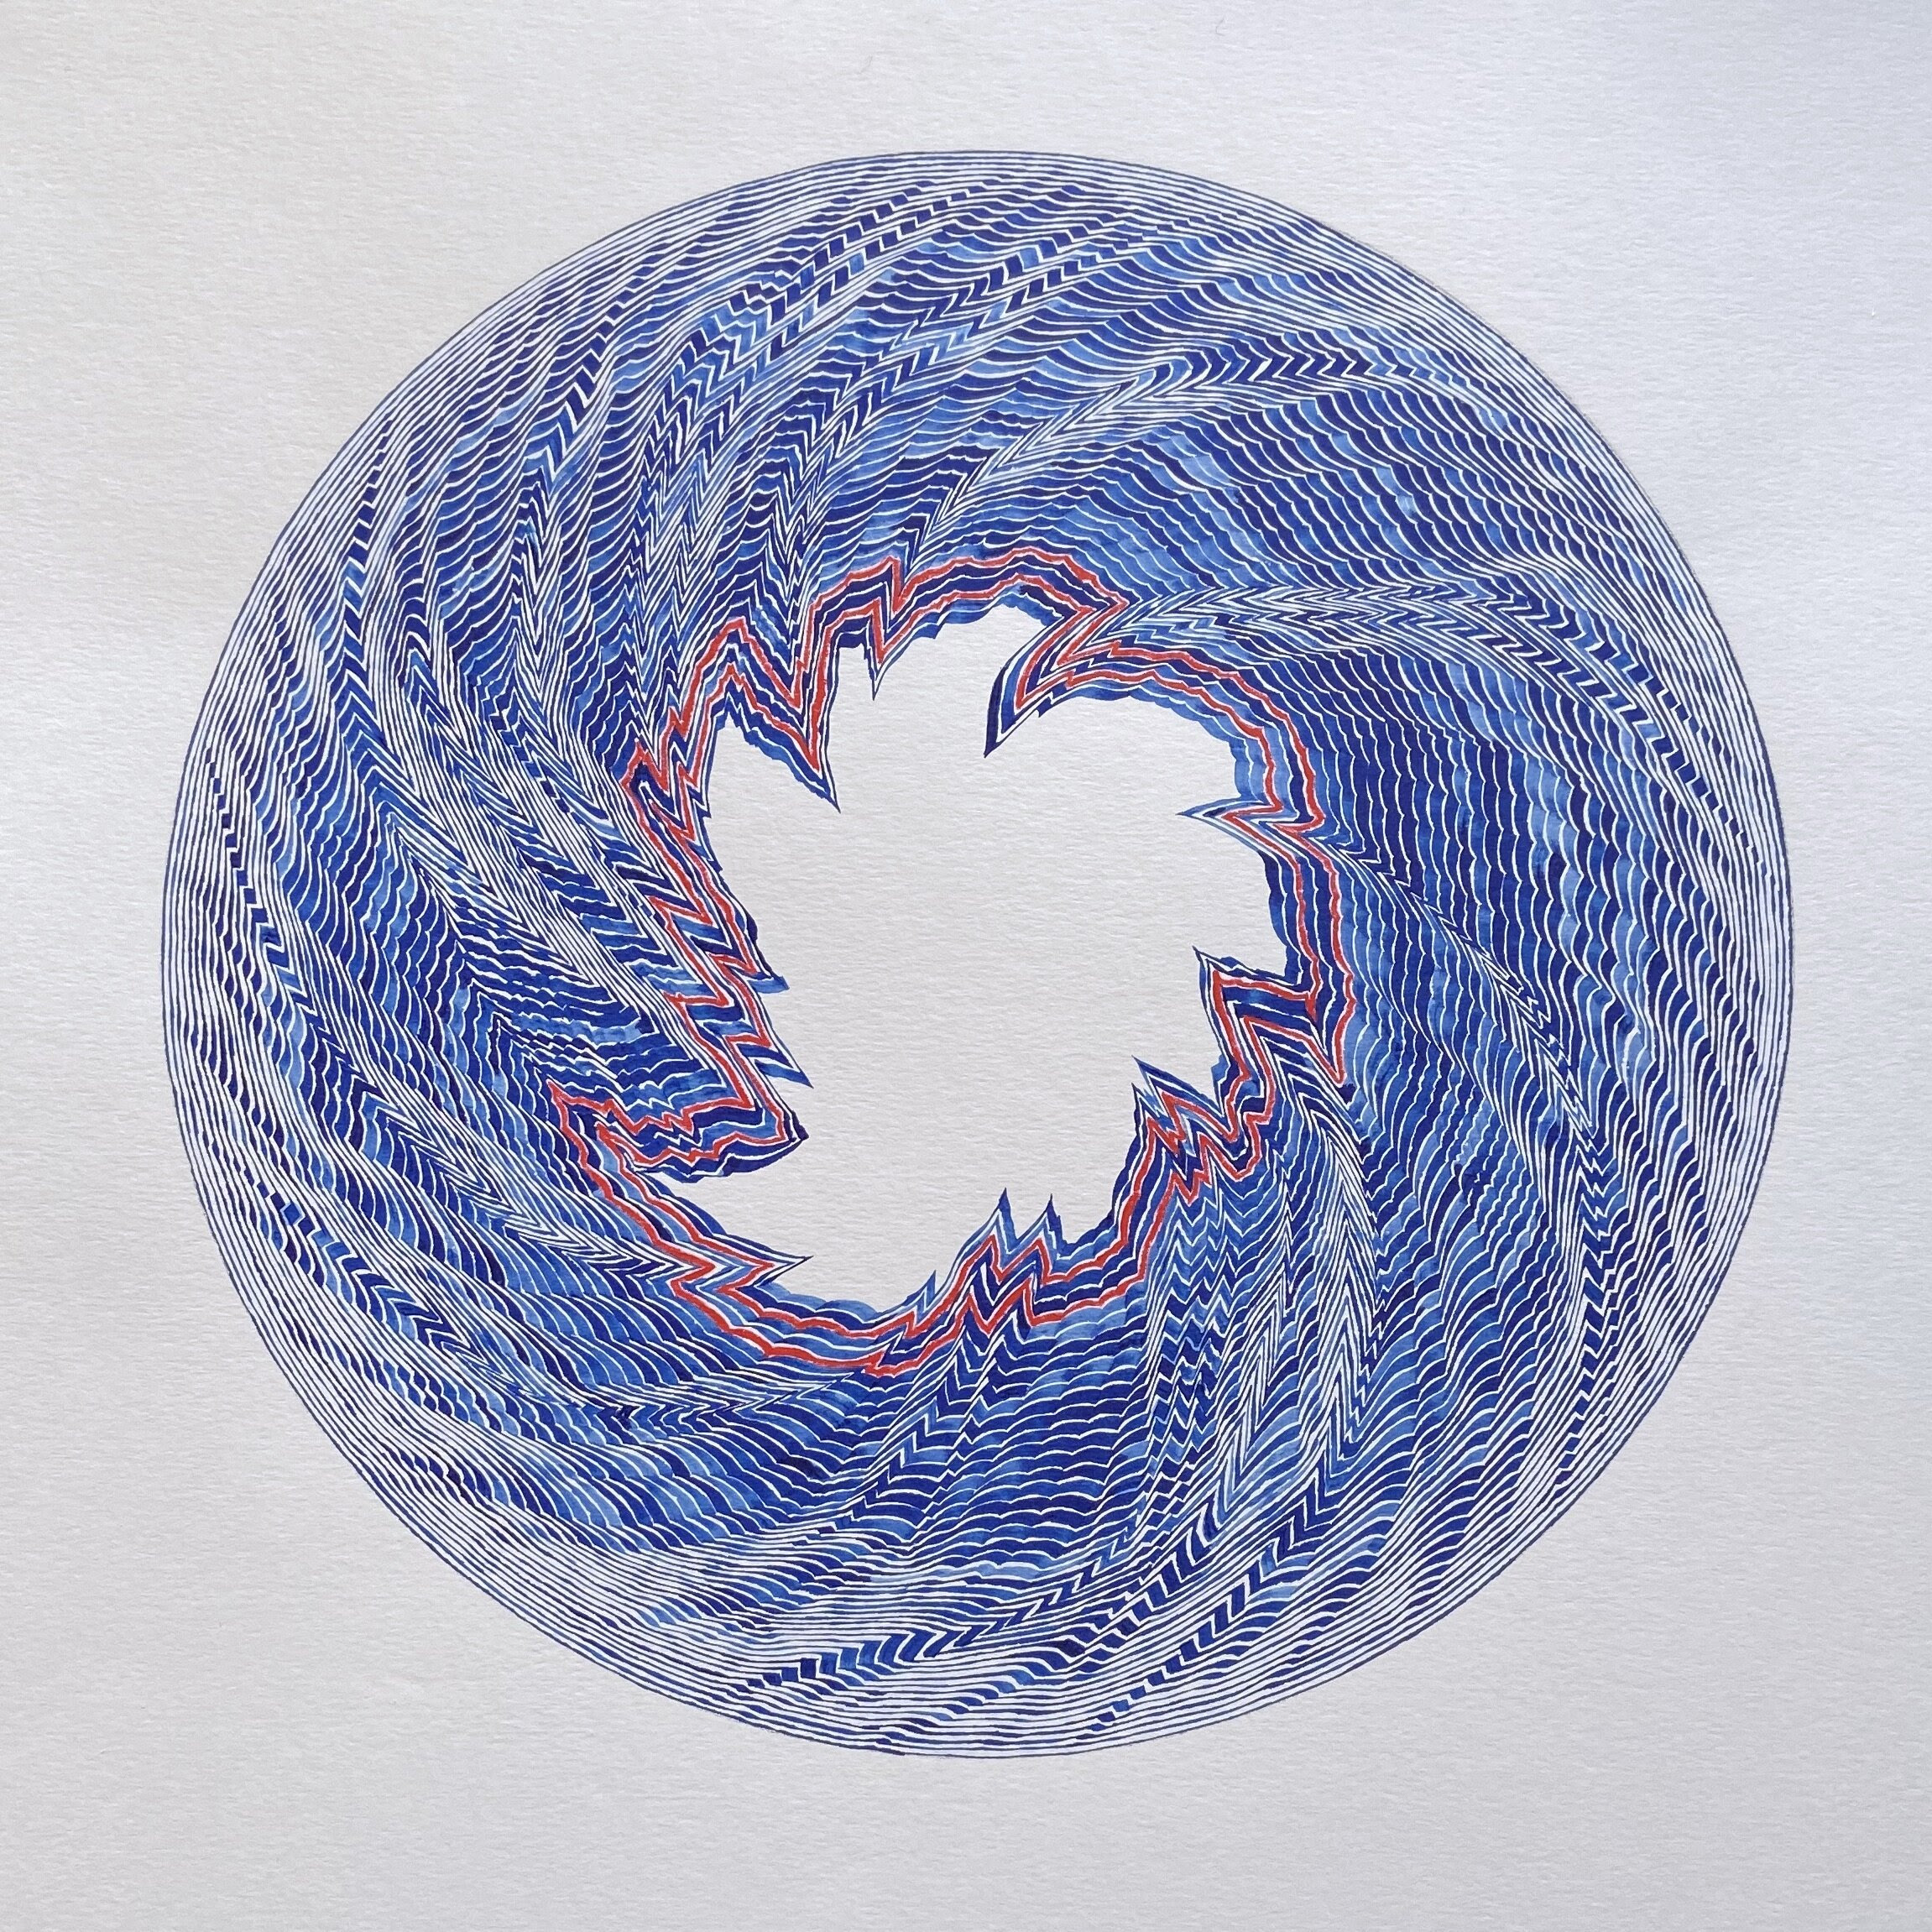
Chaos
“When the present determines the future but the approximate present does not approximately determine the future.” Edward Lorenz
https://en.wikipedia.org/wiki/Chaos_theory

Slide 16

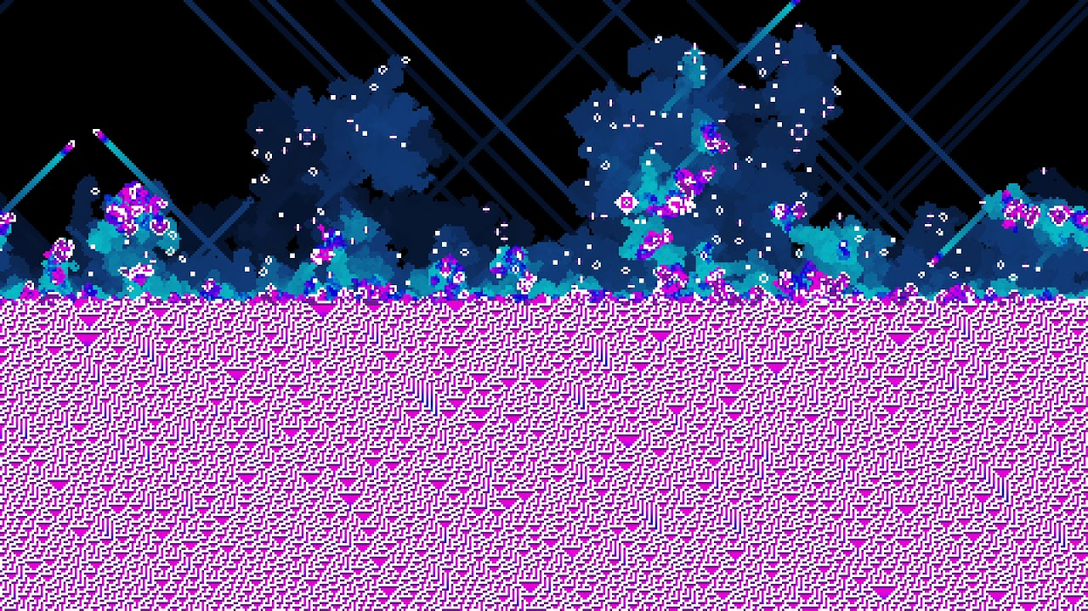
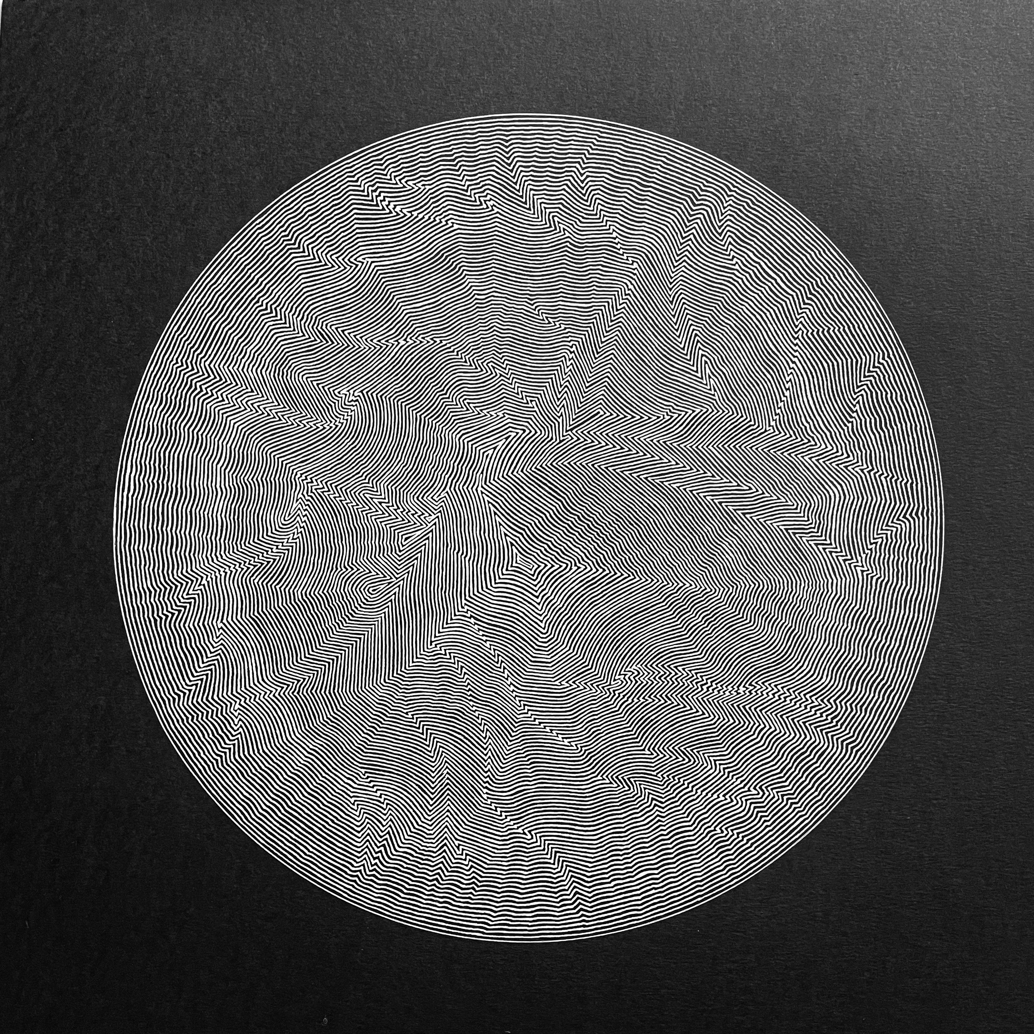
Cellular Automata Rule 30
https://github.com/elliotwaite/rule-30-and-game-of-life
https://writings.stephenwolfram.com/2019/10/announcing-the-rule-30-prizes/
https://www.geograph.org.uk/photo/5398519
https://youtu.be/IK7nBOLYzdE

Slide 17
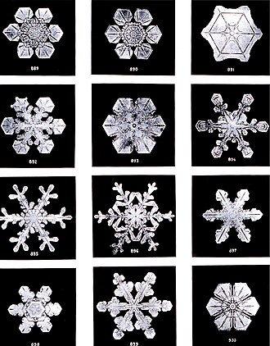
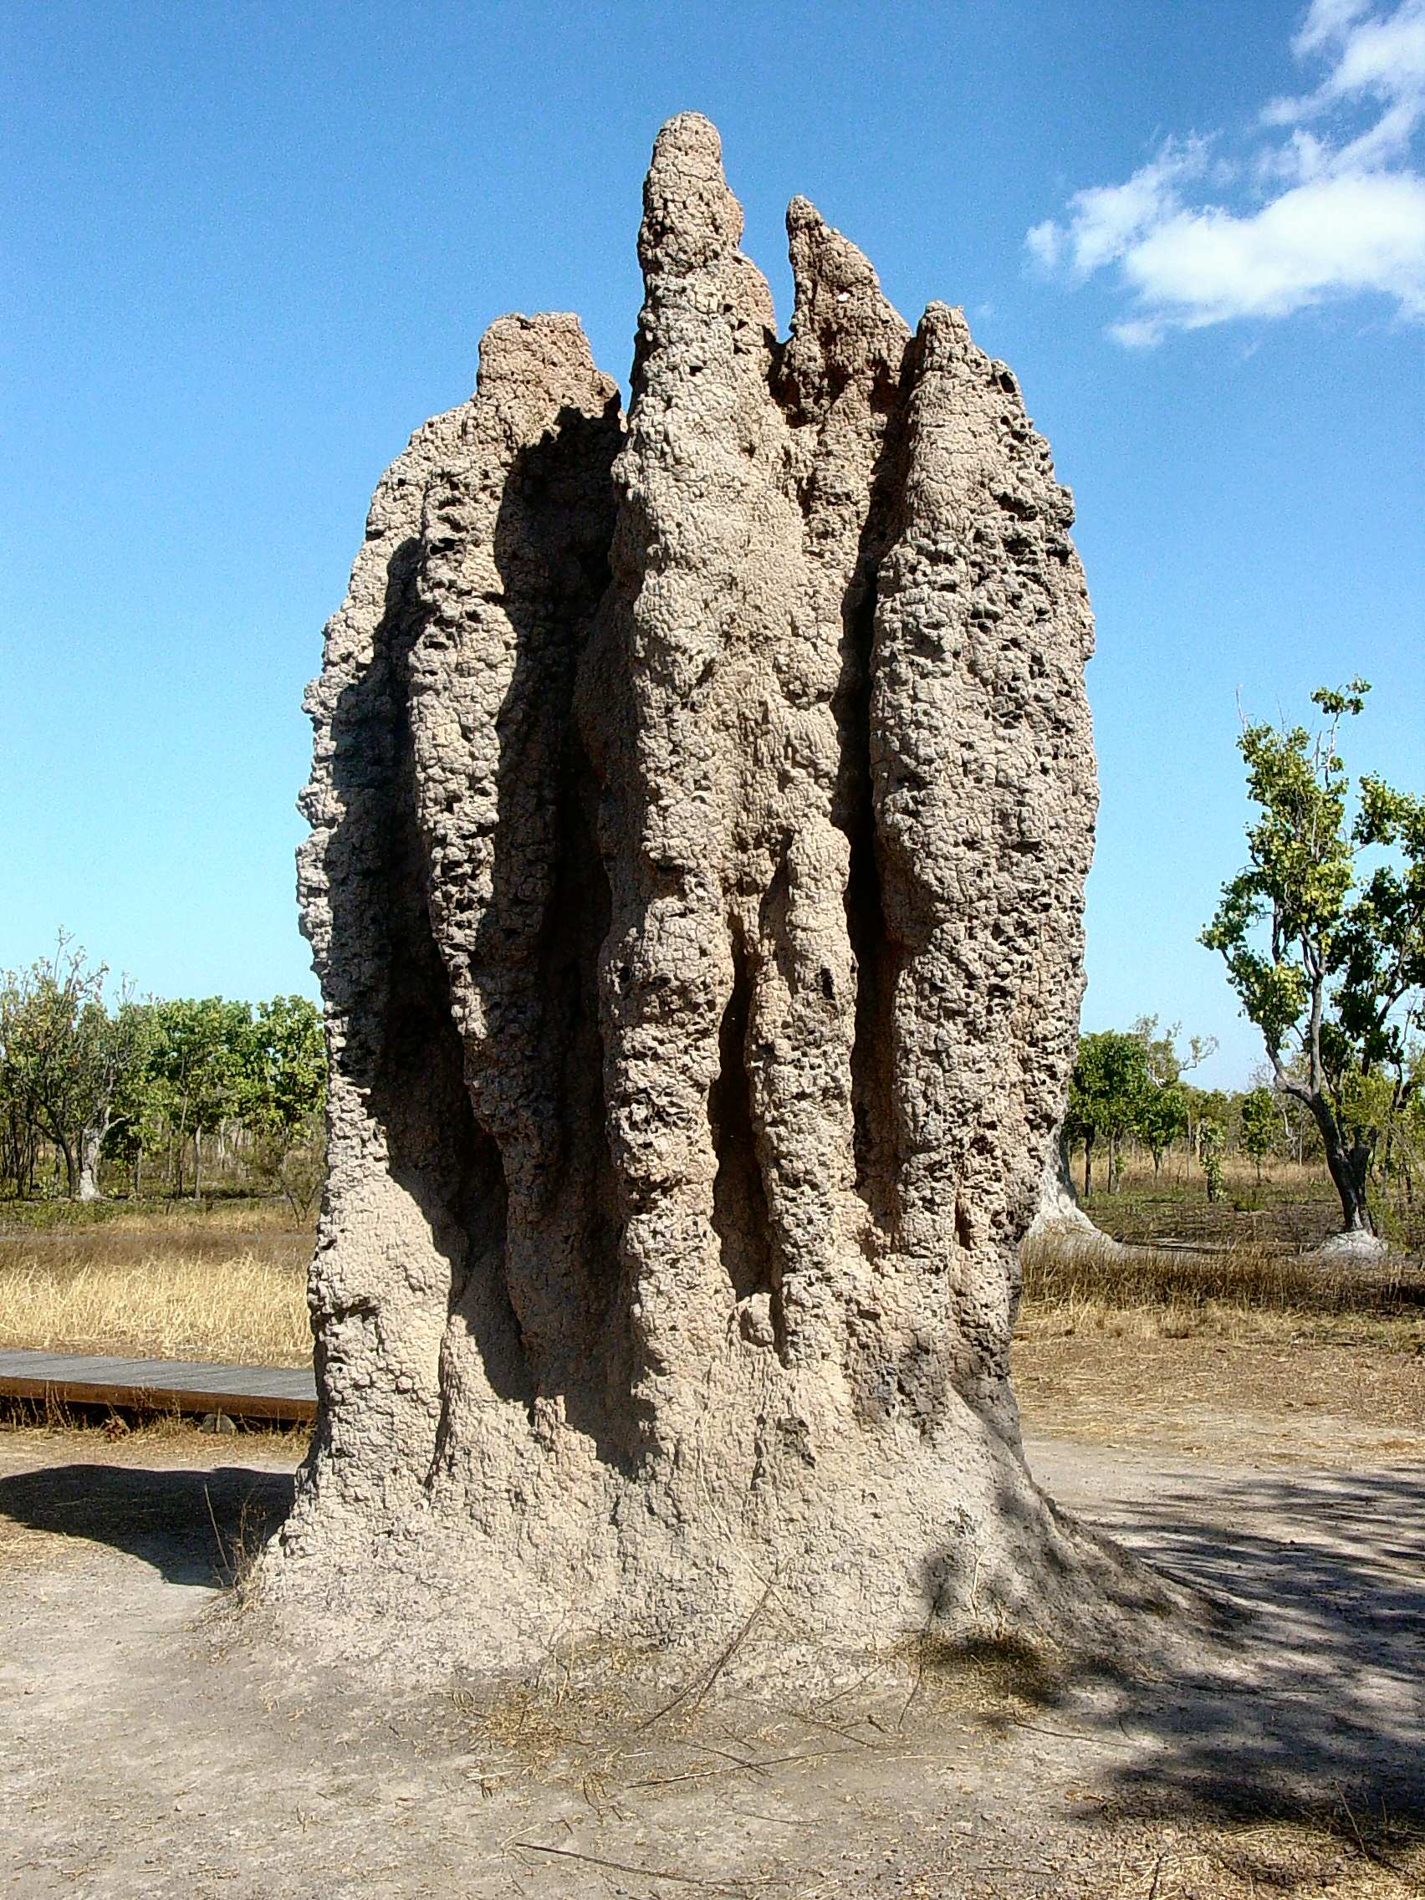
Emergence
Termite mound
https://en.wikipedia.org/wiki/Emergence

Slide 18
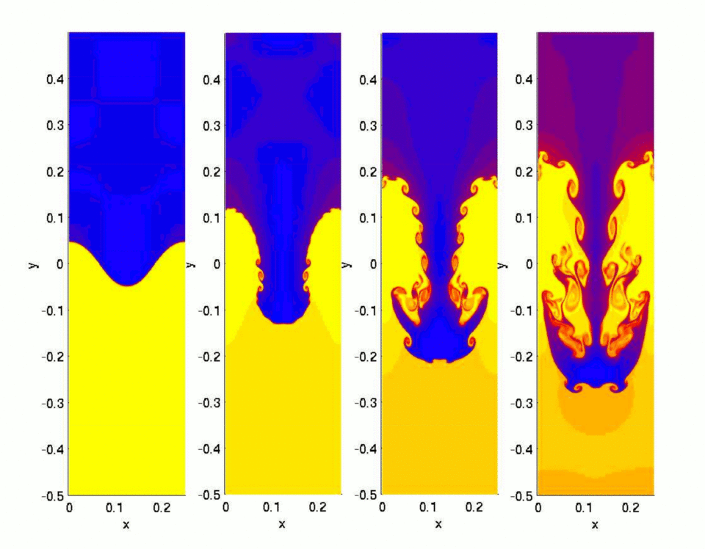
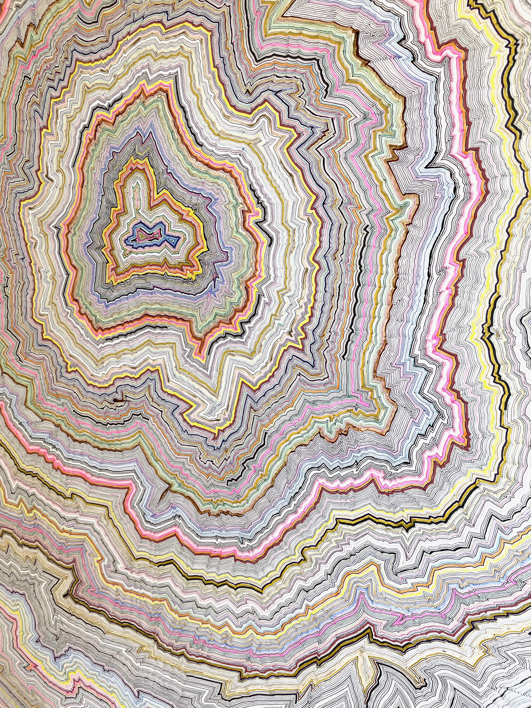
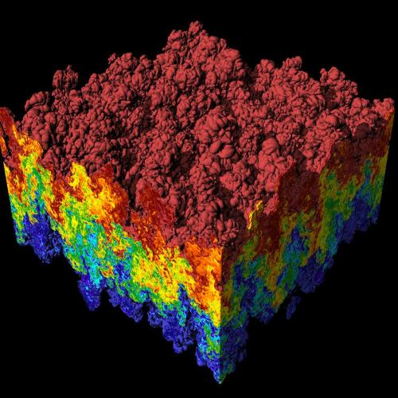
Instability and Tipping Point
https://en.wikipedia.org/wiki/Rayleigh%E2%80%93Taylor_instability

Slide 19
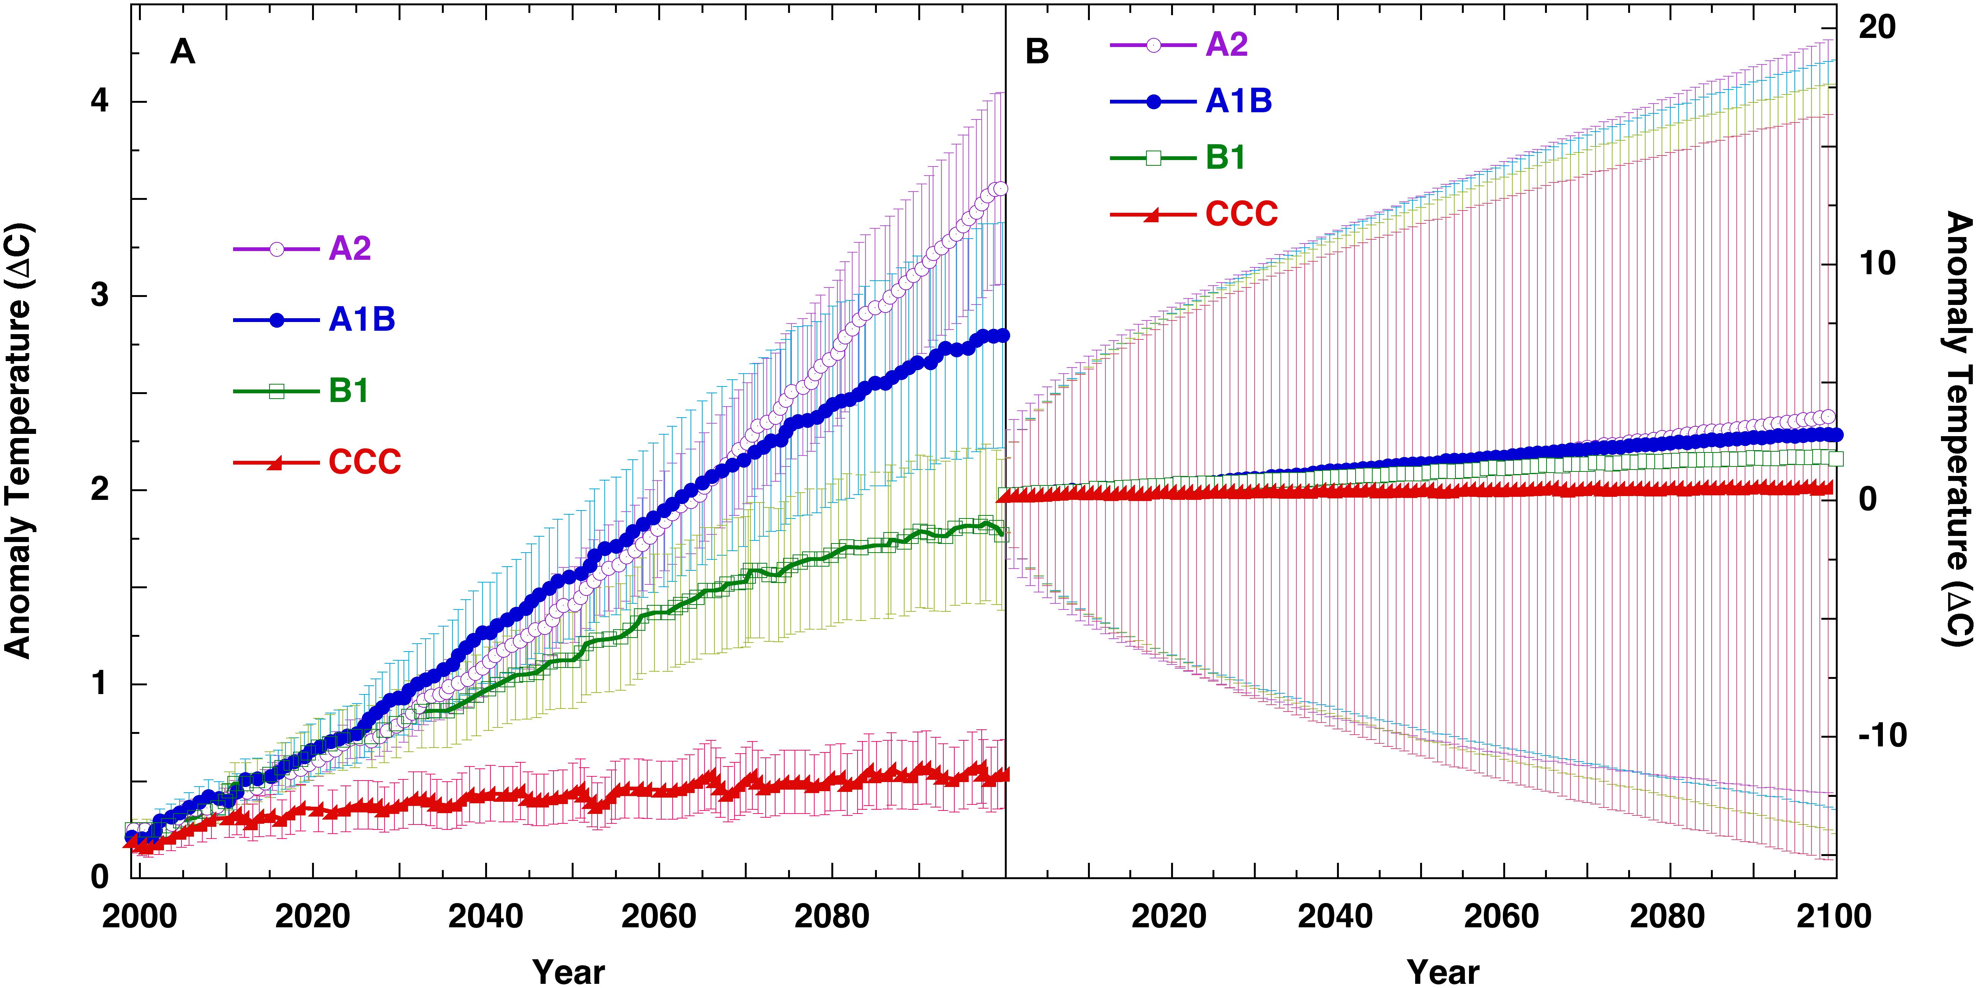
Time-series variation and error
Figure 6. Panel (A), SRES scenarios from IPCC 4AR WGI Figure SPM.5 (IPCC, 2007),
with uncertainty bars representing,
“the±1 standard deviation range of individual model annual averages.”
https://www.frontiersin.org/journals/earth-science/articles/10.3389/feart.2019.00223/full
https://www.frontiersin.org/files/Articles/452488/feart-07-00223-HTML-r2/image_m/feart-07-00223-g006.jpg

Slide 20
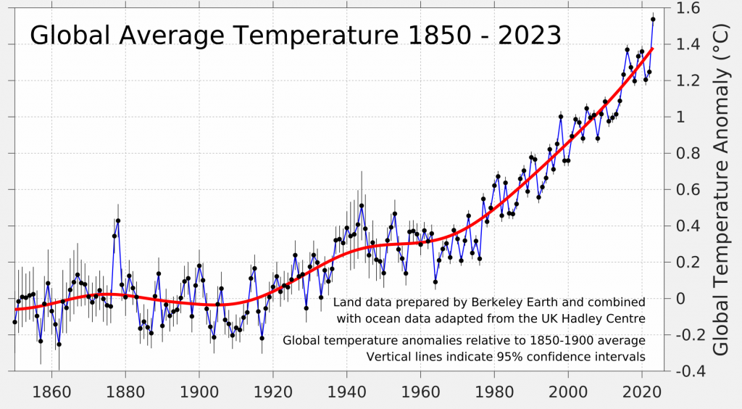
Variations and Errors
https://berkeleyearth.org/global-temperature-report-for-2023/

Slide 21
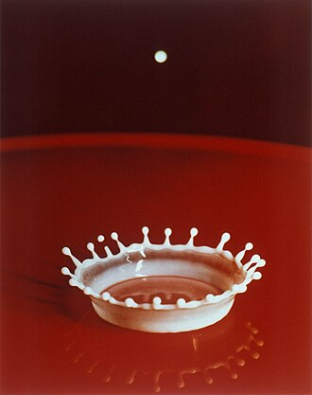
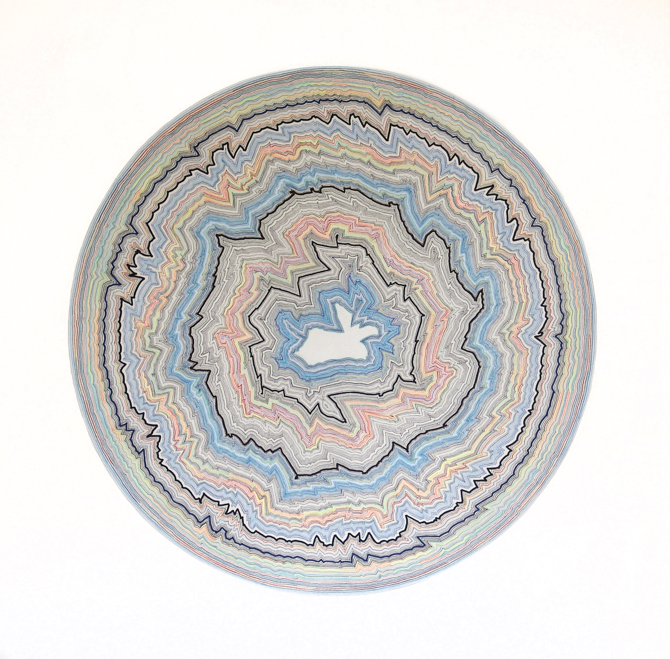
Symmetry Breaking
https://en.wikipedia.org/wiki/Milk_Drop_Coronet

Slide 22
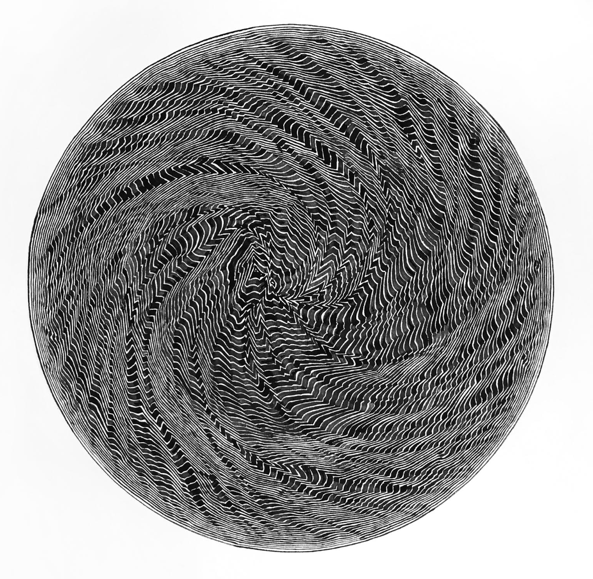
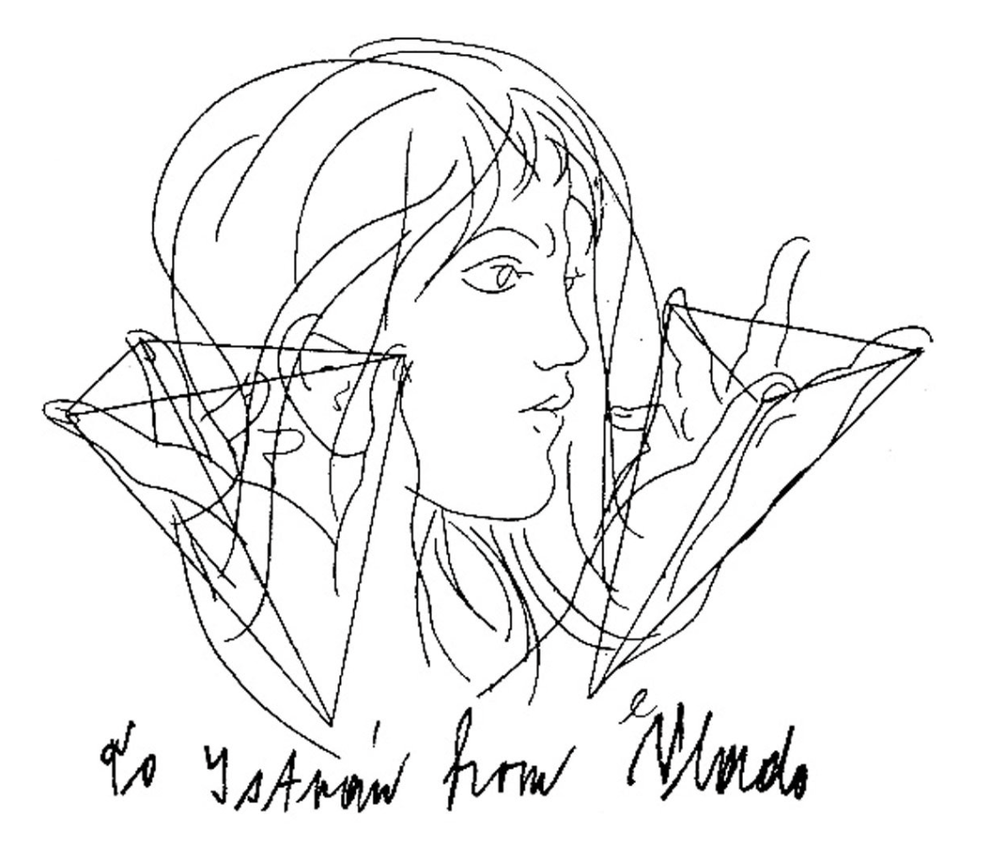
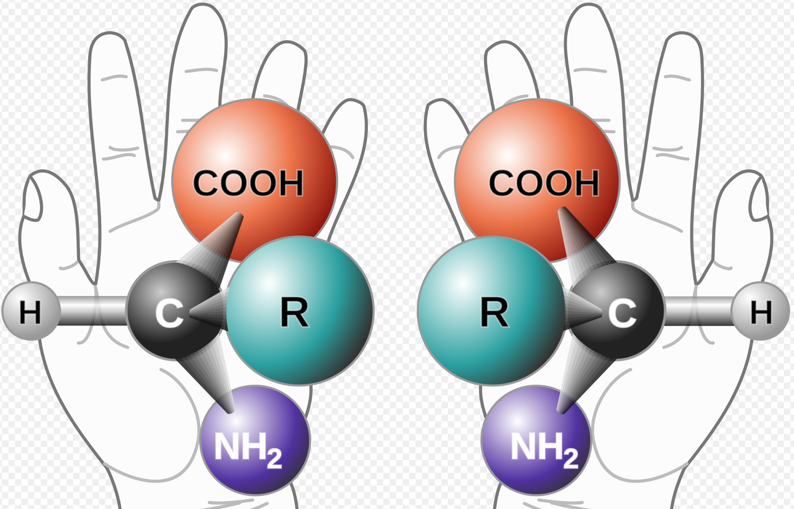
Chirality
https://www.iucr.org/news/newsletter/volume-32/number-3/eternal-chirality
https://en.wikipedia.org/wiki/Chirality_(chemistry)

Slide 23
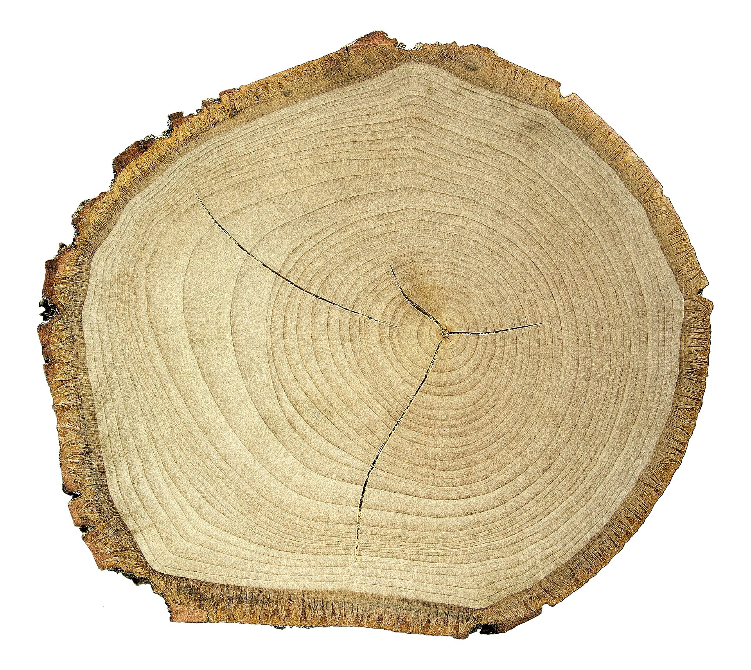
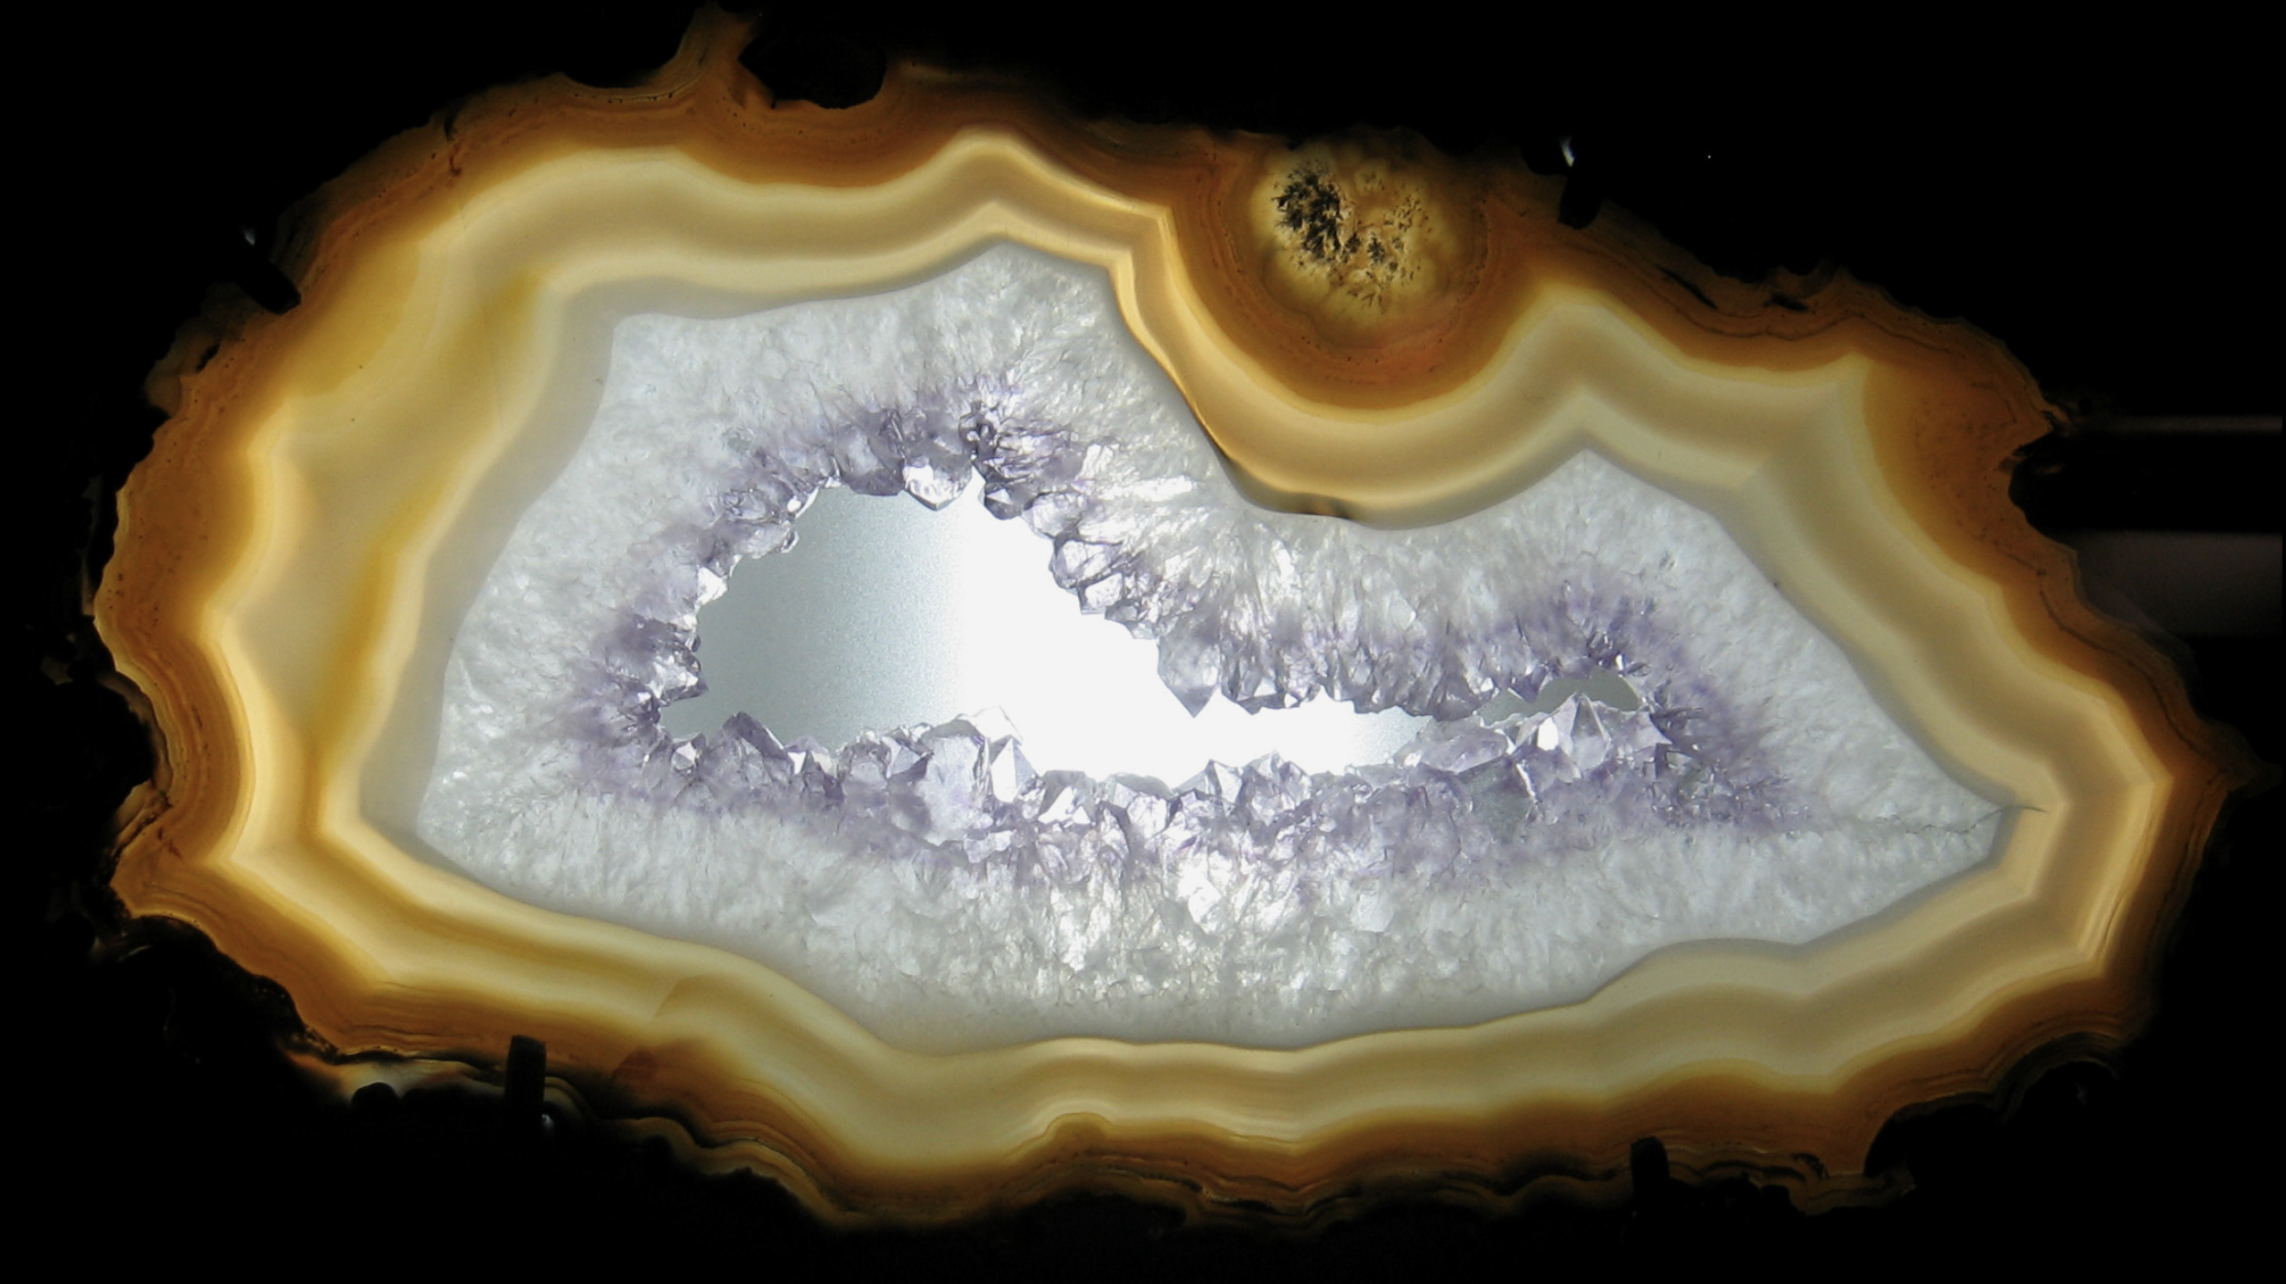
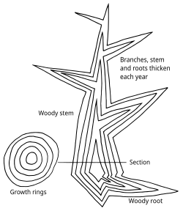
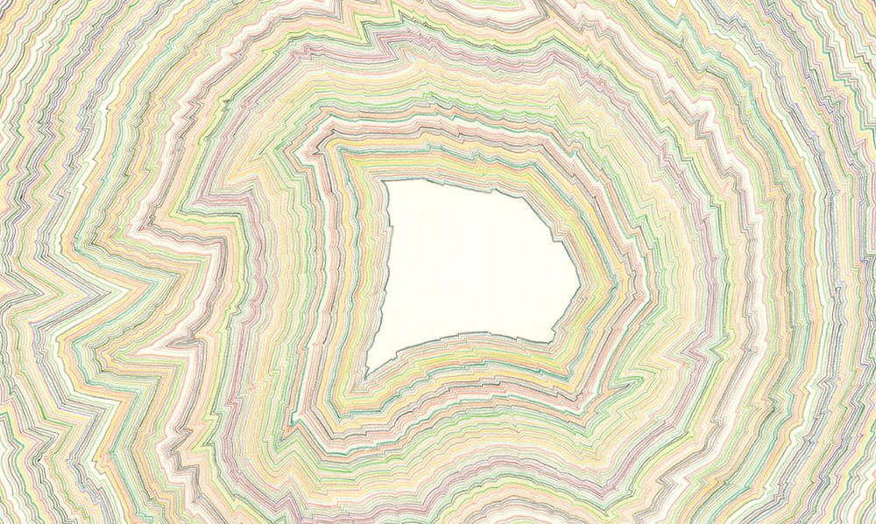
Layers
https://commons.wikimedia.org/wiki/Category:Geodes
https://en.wikipedia.org/wiki/Dendrochronology

Slide 24
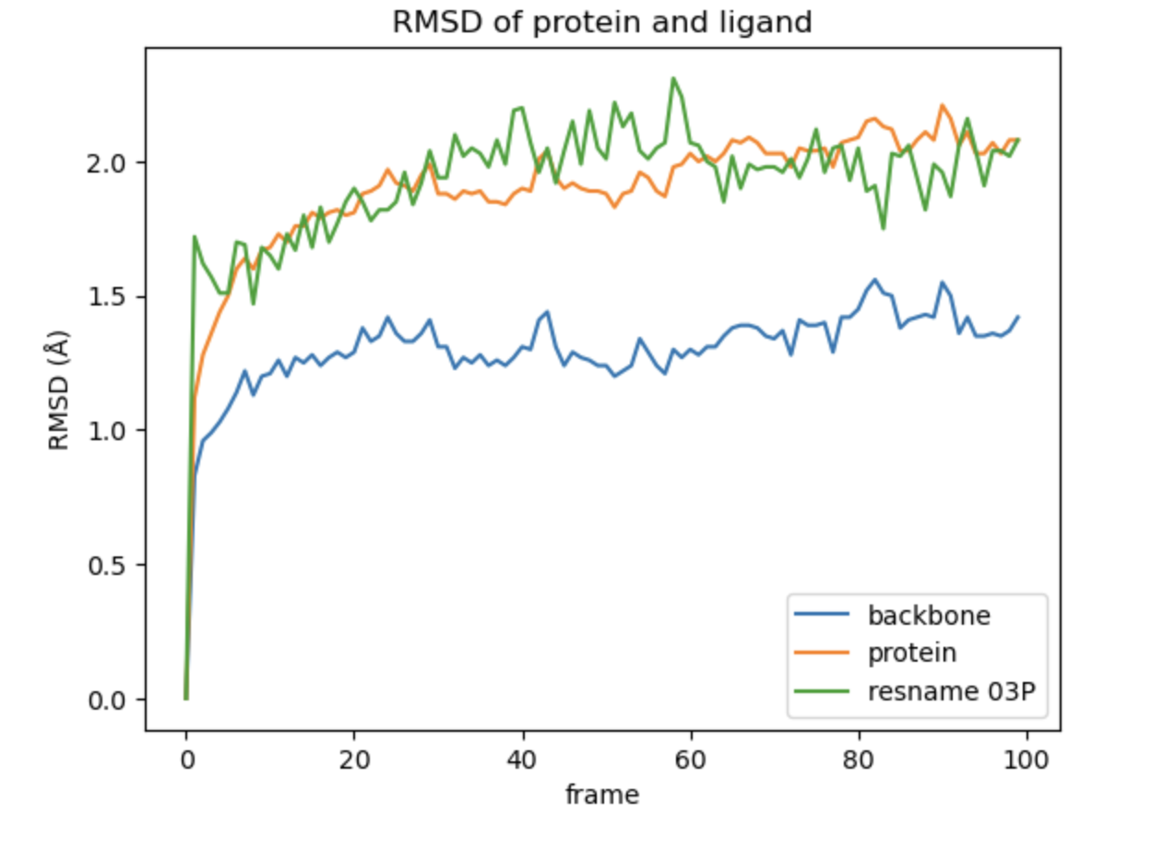
Molecular Dynamics
https://projects.volkamerlab.org/teachopencadd/talktorials/T020_md_analysis.html

Slide 25
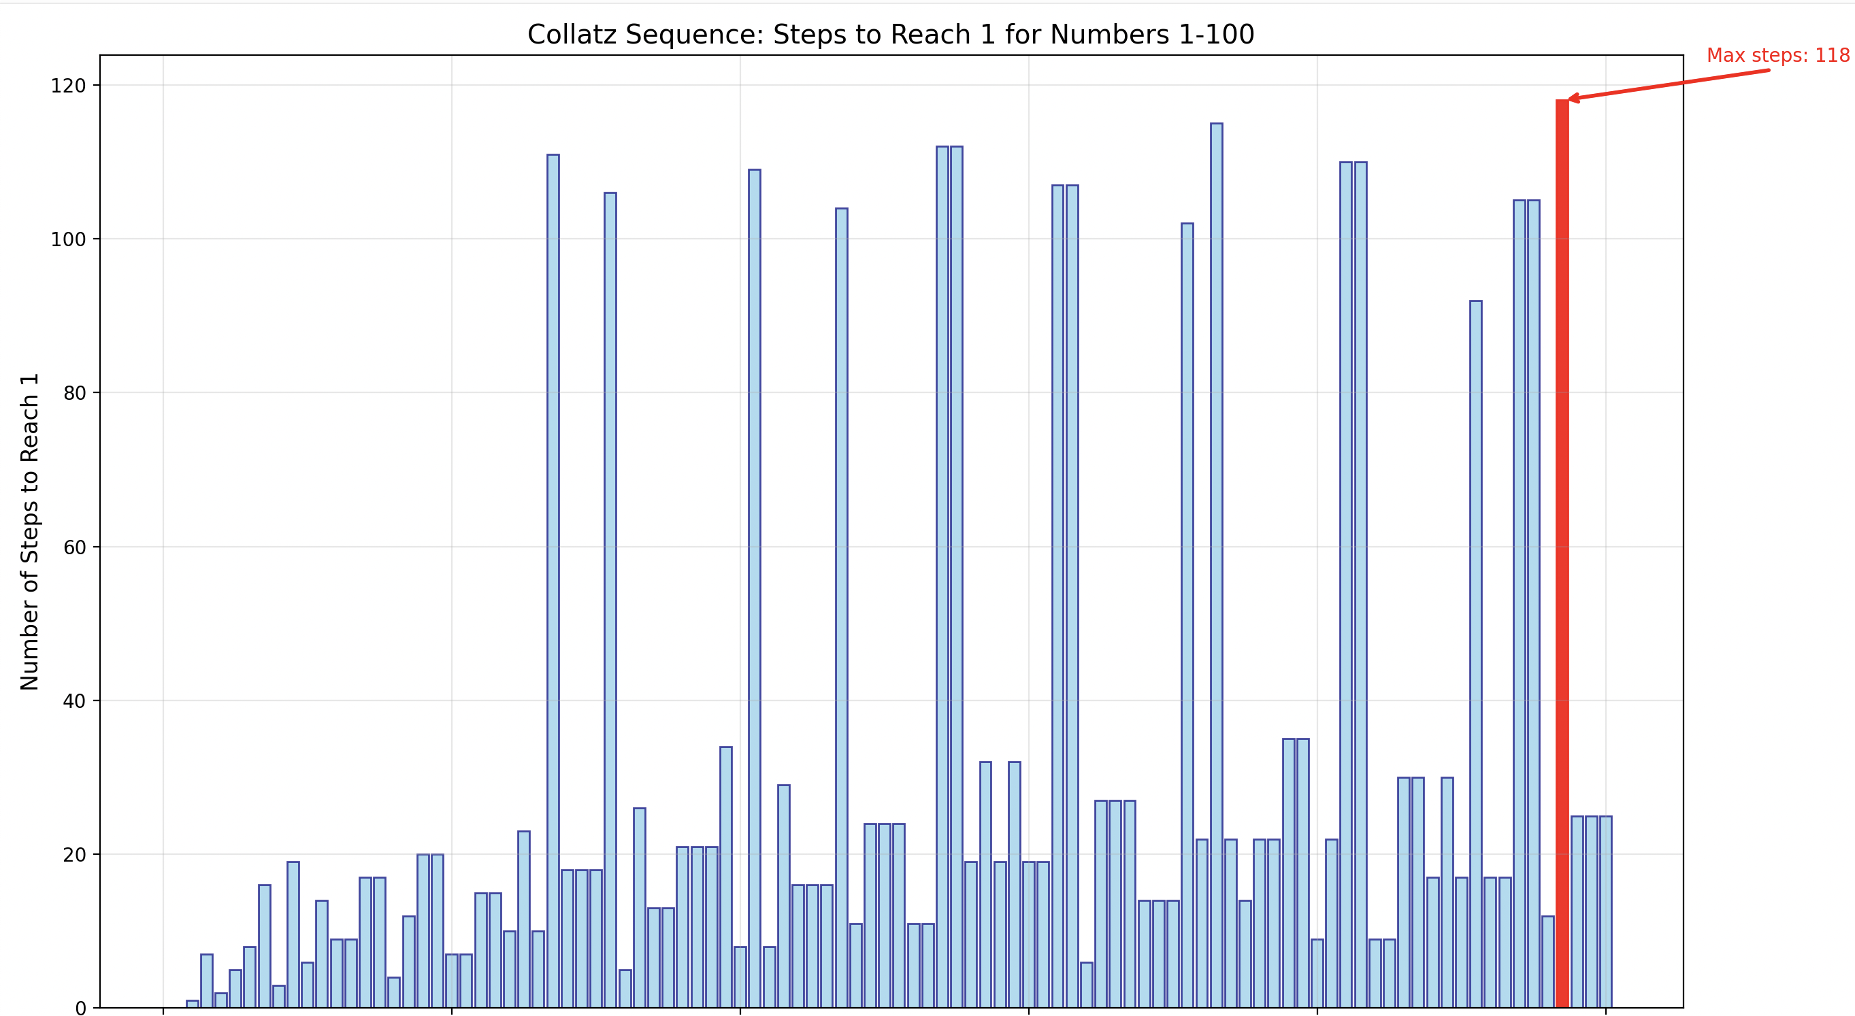
Algorithm
print("Rules:") print("- If the number is even, divide by 2") print("- If the number is odd, multiply by 3 and add 1") print("- Keep going until you reach 1") print("- Then pick a new number or stop") print("- Range: 1 to 100") print()

Slide 26
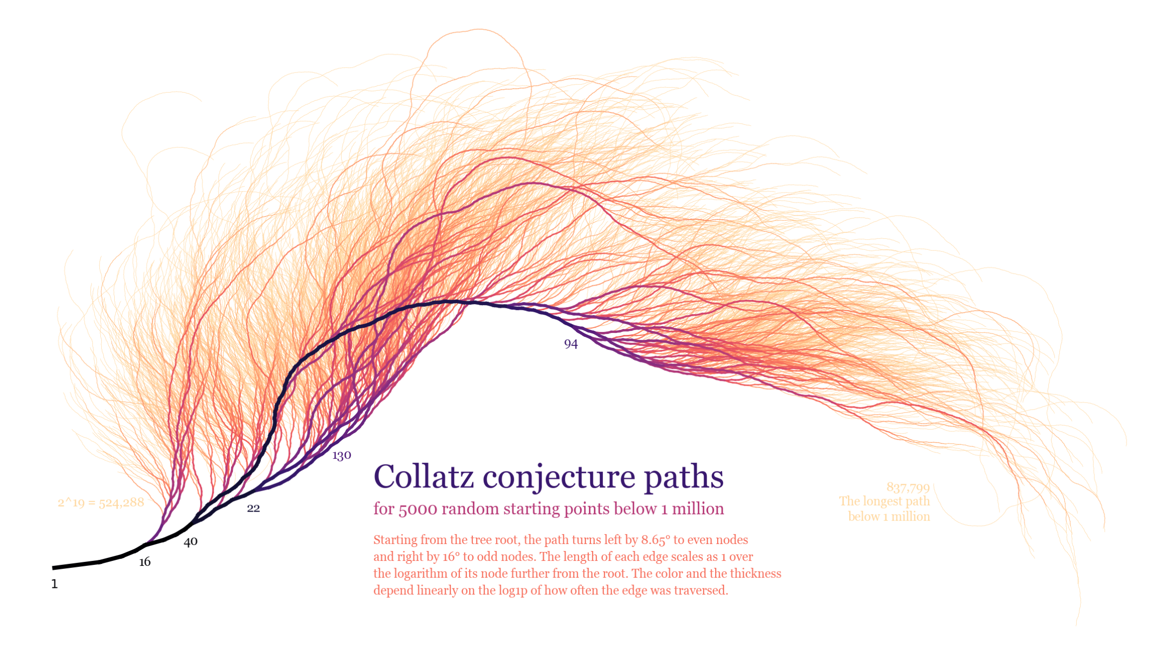

Slide 27
Conversation with ChatGPT
Kirsten : May I show you a picture of an artwork and ask you to respond to it ?
ChatGPT said:
Absolutely — please go ahead and upload the image of the artwork. Once I’ve seen it, feel free to ask your question or let me know how you'd like me to respond (e.g., interpretation, critique, title suggestion, etc.).
Kirsten : interpretation please
ChatGPT said:
Thank you for sharing the image — it’s a striking piece.

Slide 28
Conversation with ChatGPT
ChatGPT said: Here's a layered interpretation, moving from the visual and formal to the conceptual:
1. Visual/Formal Analysis
Line and Movement: The tightly packed, undulating white lines create a powerful sense of vibration and movement, as though the image is pulsing or breathing. The visual rhythm shifts as you move across the circle, with areas of turbulence and calm, suggesting a dynamic inner life.
Structure and Disruption: At first glance, the lines appear evenly spaced, but closer inspection reveals purposeful distortions — zigzags, bends, and convergences. These disruptions interrupt any sense of symmetry and push the viewer to look closer, to seek the underlying pattern — if there is one.
Circular Form: The circle often symbolizes unity, wholeness, or the cosmos. In this case, it could be read as a bounded field of energy, a closed system undergoing complex internal transformations.

Slide 29
Conversation with ChatGPT
2. Emotional/Tonal Reading
There’s an almost hypnotic quality to the piece — it invites prolonged contemplation but resists easy resolution.
The interplay between order and chaos creates emotional tension: the comfort of repetition is constantly unsettled by unexpected deviations.
This tension might evoke a sense of instability or flux, as though the image is a snapshot of something that’s constantly in the process of becoming.

Slide 30
Conversation with ChatGPT
3. Conceptual/Thematic Possibilities
Error and Precision: The work feels simultaneously algorithmic and human — as if it could have been plotted by a machine but with a glitch, or perhaps made by hand with extreme discipline and intentional variation. This tension could reflect themes of imperfection within systems, or human presence within the mechanical.
Topography of the Mind or Sound: The forms could be interpreted as a kind of map — neural, emotional, or sonic. It recalls topographic maps, fingerprint whorls, or soundwaves distorted in transmission.
Time and Process: It’s also possible to read the image as a record of time, with each line like a sedimentary layer — a slow accumulation of decisions, gestures, or iterations.

Slide 31
Conversation with ChatGPT
Chat GPT said : If you'd like me to pair it with a text/poem, I’d be happy to help.
🌀 1. Original Poem – Written in Response to the Artwork
“Field of Deviations” by ChatGPT, in response to your image
Within the circle, nothing stays still— a hundred lines remember straightness, then forget.
They wander like thought under pressure, zigzagging in silence, tracing the seams of some unseen logic.
A whisper of order— then rupture, a wave collapsed into another.
Is this how a mind looks when it’s almost calm?
Is this how time curls before it breaks?

Slide 32
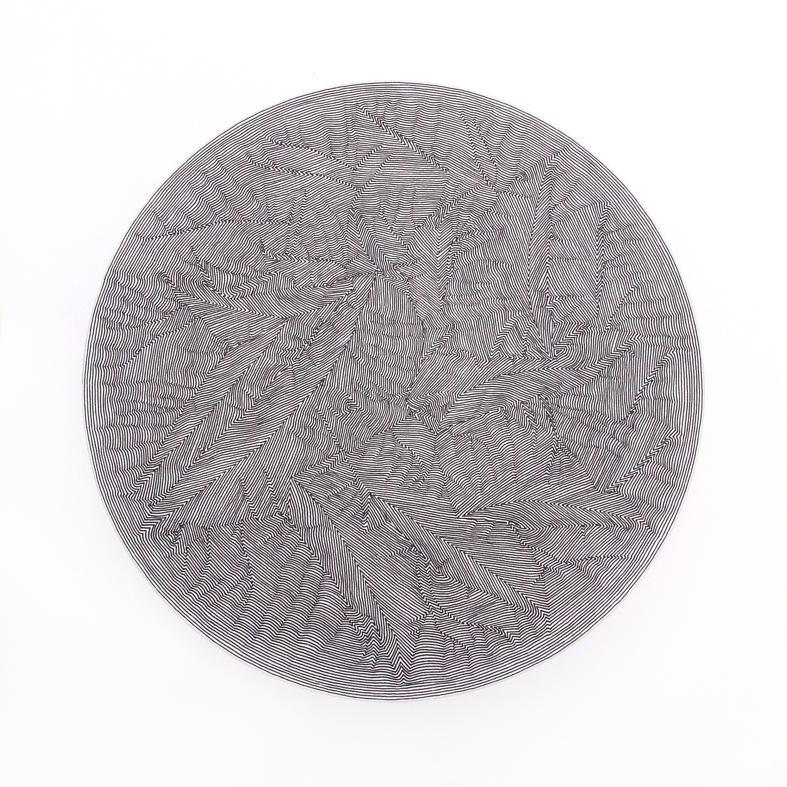
Conversation with ChatGPT
Kirsten asked: Please could you respond to this scientific diagram
Chat GPT said : This circular line diagram could be read scientifically as a kind of contour map, interference pattern, or data visualization, though without a legend or axis labels, it resists a direct “this-means-that” reading. Here’s a breakdown of possible interpretations through a scientific lens:
1. Visual Structure
The symmetrical yet imperfect distribution could point to natural systems that have both order and chaotic perturbations.
2. Possible Scientific Analogues
Topography / Geophysics: Could resemble a stylised elevation map of a mountainous or fractured terrain, with peaks and valleys encoded by line density and curvature.
3. Scientific-Philosophical Reading It embodies the beauty of emergent patterns in complex systems: whether in weather systems, geological processes, or human-made algorithms, these structures are byproducts of rules interacting over time.

Slide 33

Developing AtPoE program with AI

Slide 34
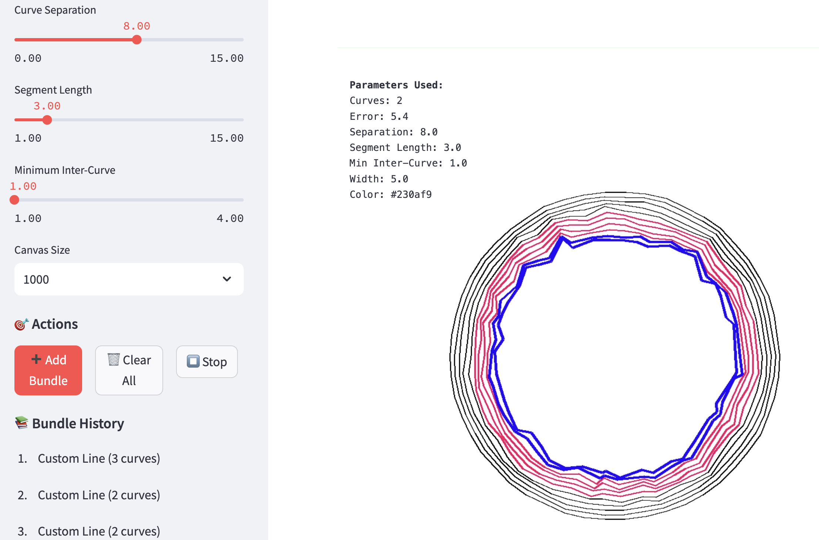
AtPoE program

Slide 35
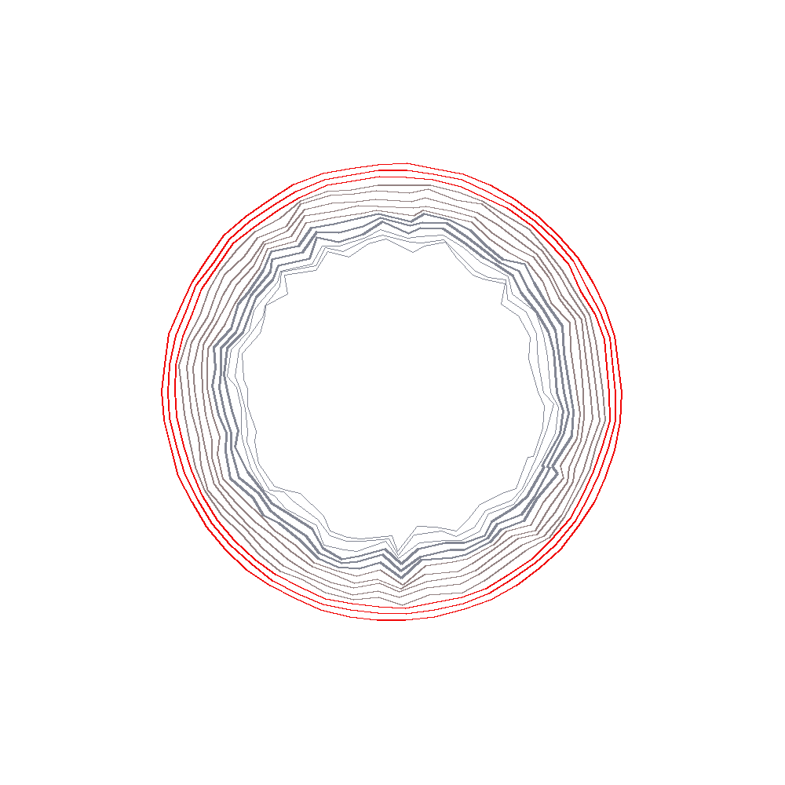
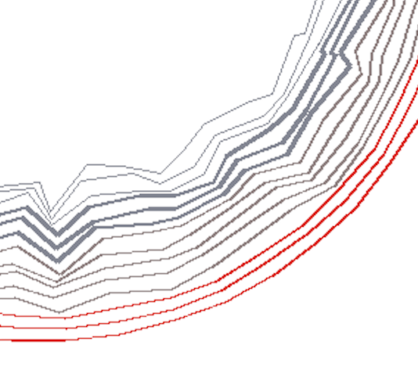
Atpoe_curves_4

Slide 36
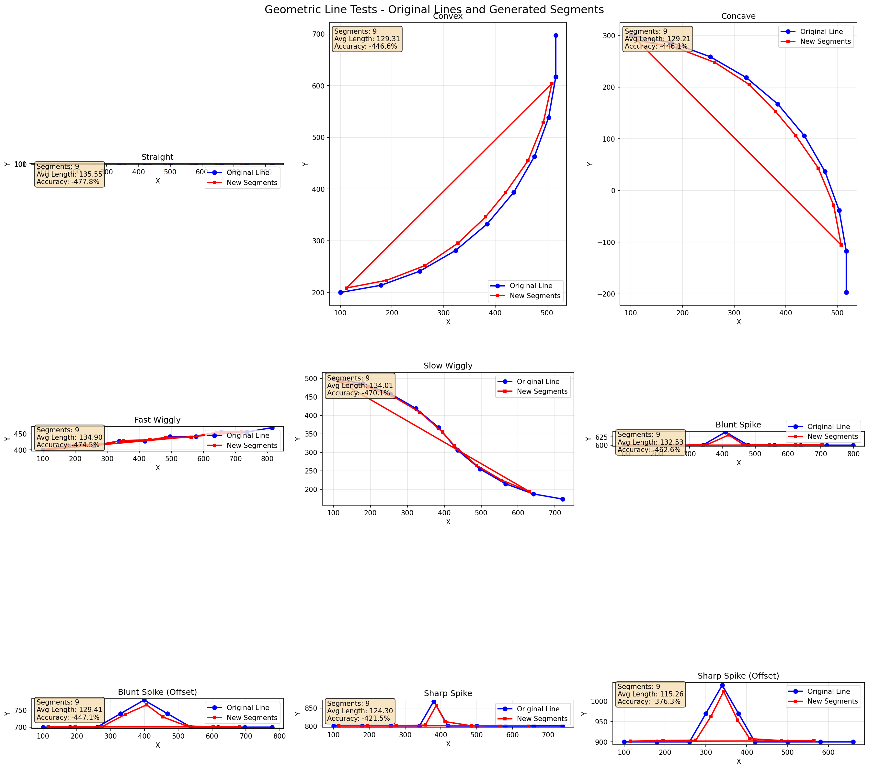

Slide 37
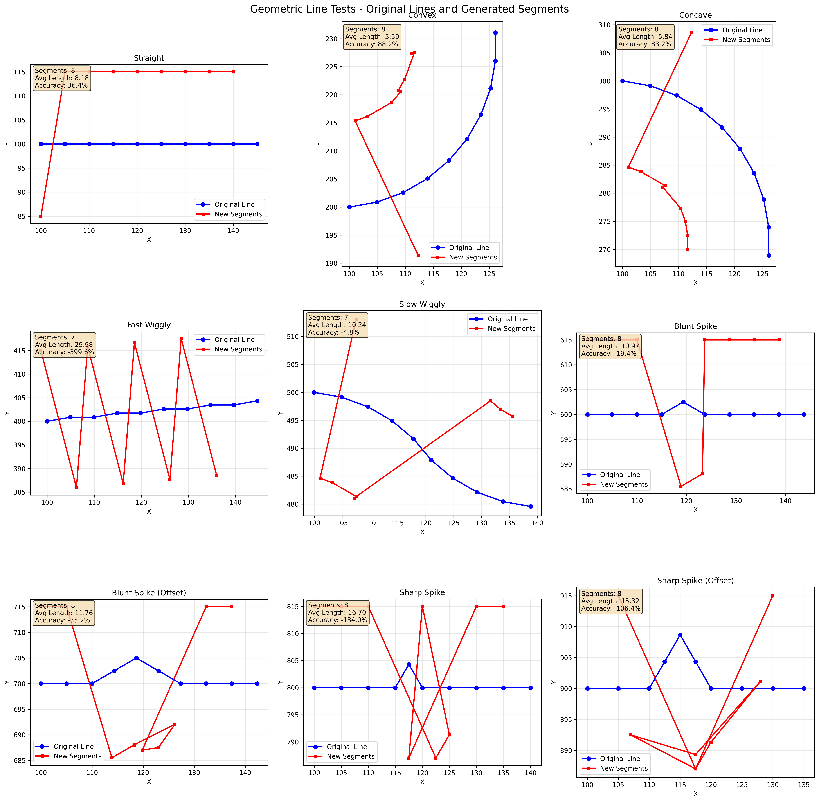

Slide 38
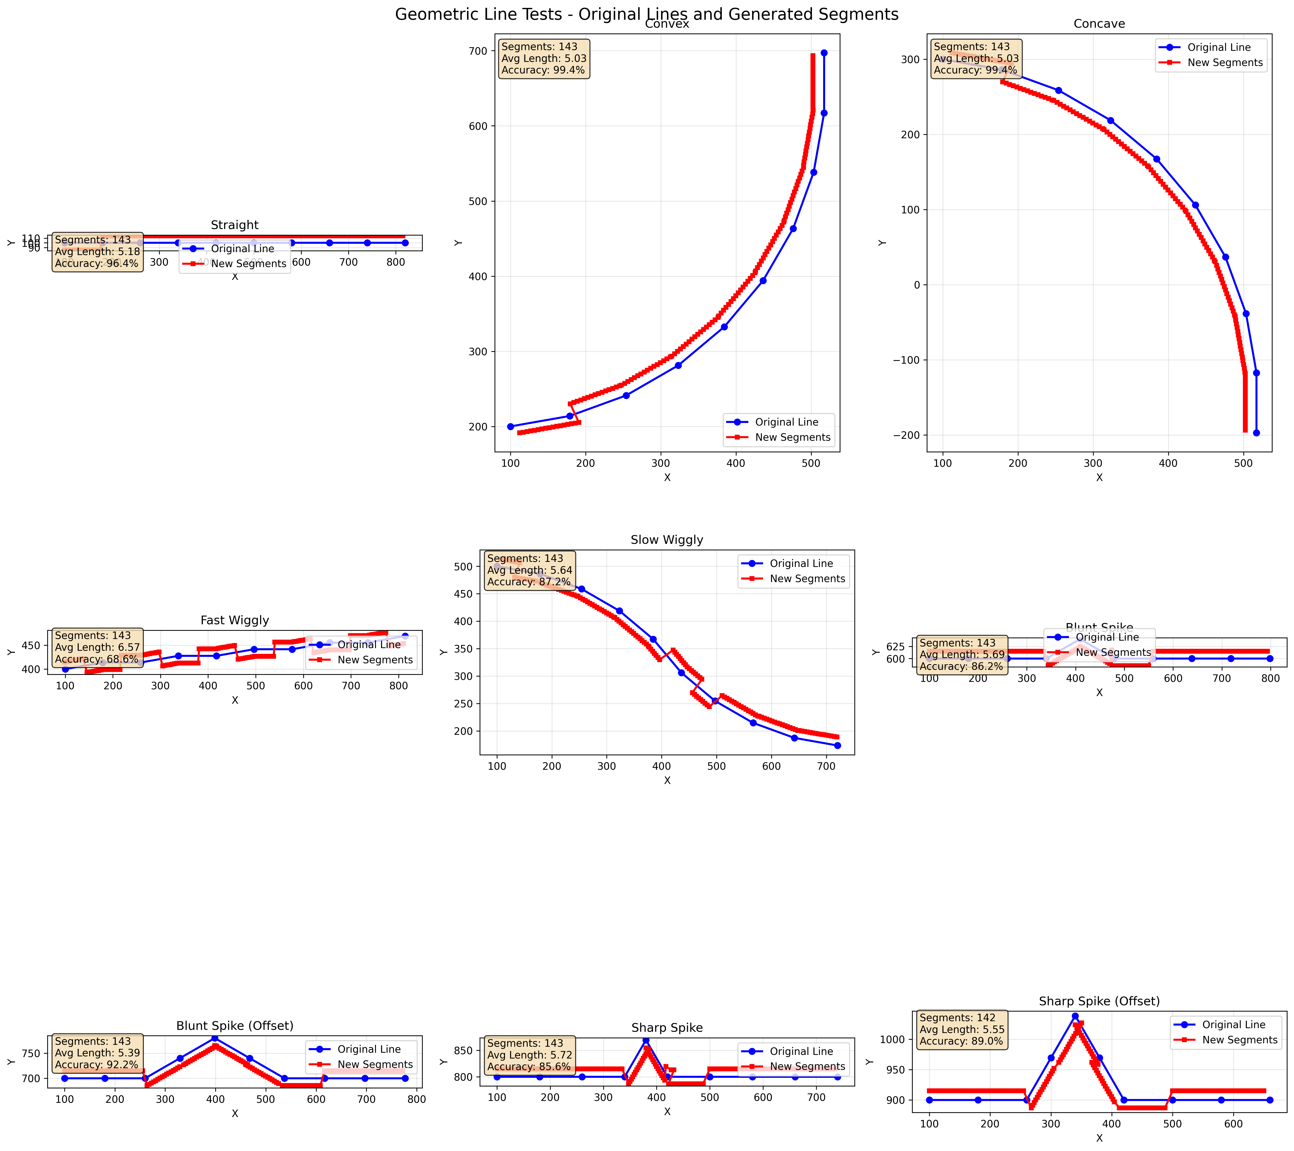

Slide 39
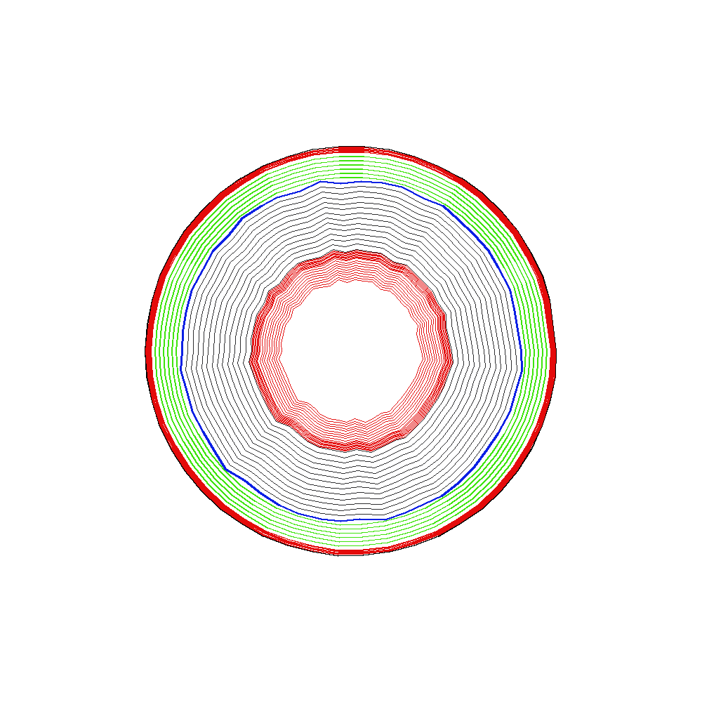

Slide 40
kirstenlavers.net
pm286@cam.ac.uk

Slide 42
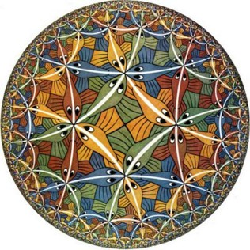
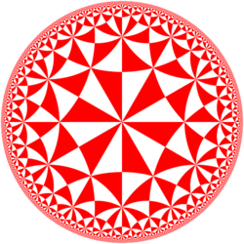
Maurits Escher
https://en.wikipedia.org/wiki/M._C._Escher
https://en.wikipedia.org/wiki/Circle_Limit_III

Slide 43

Steel Grains
https://commons.wikimedia.org/wiki/File:Grain-oriented_electrical_steel_(grains).jpg

Slide 44
https://en.wikipedia.org/wiki/Personal_equation
https://en.wikipedia.org/wiki/Emergence

